Slide 1


Building Affordable Residential Housing Projects for Middle-class Homebuyers In Costa Rica

Slide 2



Westfalia Developments: Fast Facts
Westfalia Developments specializes in affordable residential housing projects for middle-class homebuyers in Costa Rica. We target underserved markets outside the Greater Metropolitan Area (GAM) of the Costa Rican Capital to provide gated communities with move-in ready homes for the average citizen.
KEY HIGHLIGHTS
Westfalia Developments operates in a market facing a $15.85 billion housing deficit.
Westfalia homes are 775-860 square feet, move-in ready homes priced between $100-130k
All Westfalia housing projects are gated communities that include amenities such as club house, swimming pool, and commercial space for a convenience store.
Five premium development locations outside the San José GAM have already been identified.
INDUSTRY
Real Estate
MARKET SIZE
$15.85 billion
TARGET CUSTOMER
Middle-Class Homebuyers

Slide 3

Costa Rican
Housing Deficit
Purchasing a home is an important part of so many people´s lives.
There are thousands of middle-class potential homebuyers in Costa Rica who want to buy a home to grow their families, live independently, and signify their success.
But they can’t.

Slide 4
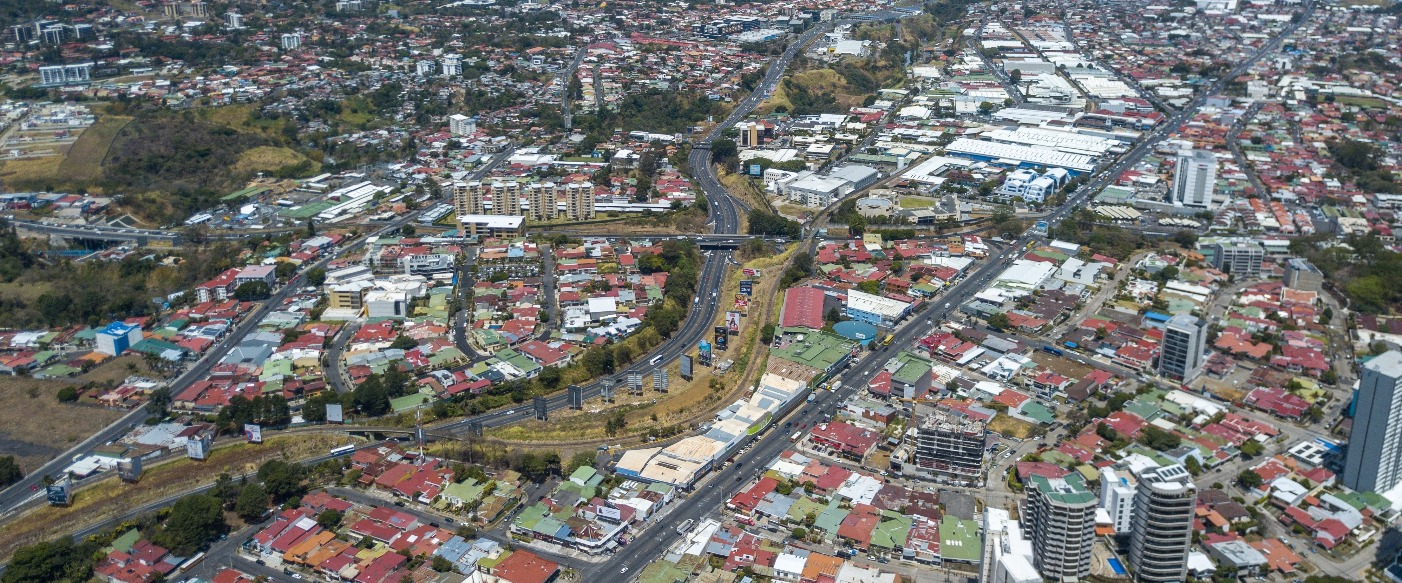
Living options outside the Greater Metropolitan Area (GAM) of the capital San José are severely limited. The majority of new construction has been focused on small rental units, which aren’t large enough for growing families and remain unattractive long-term solutions for others. Many potential homebuyers have to stay with relatives or parents because the new homes that are available are outside their budget.
Costa Rica is currently facing a $15.85 billion housing deficit.

Slide 5
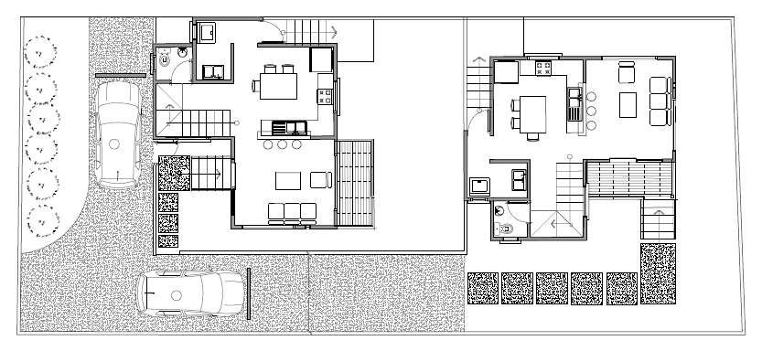
Westfalia Builds for
Middle-Class Buyers
Westfalia Developments specializes in affordable residential housing projects for middle-class homebuyers in Costa Rica. We target underserved markets outside the Greater Metropolitan Area (GAM) of the Costa Rican Capital to provide gated communities with move-in ready homes for the average citizen.
We will build new, move-in ready homes that are affordable for the largest segment of potential homebuyers. Those with the desire and means to purchase a home will be able to own property within a gated community, complete with amenities like a swimming pool and clubhouse.
Westfalia Developments will literally change the housing market landscape with new affordable homes for middle-class buyers.

Slide 6
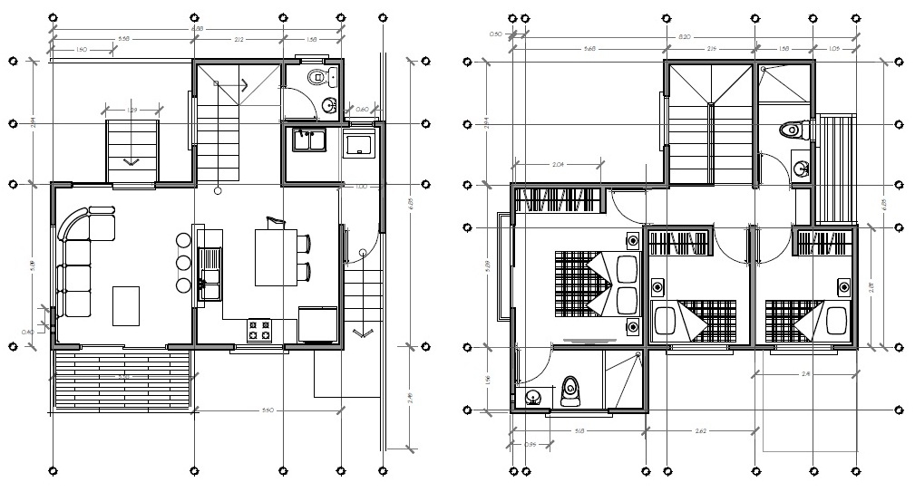
The Homes:
Features
Each Westfalia project will feature 370-420 homes within a gated community outside the San José GAM. Every home will feature enough space to live and grow:
775-860 square foot floor plans
3 bedrooms, 2 bathrooms
Living room
Kitchen
Personal yard
2 parking spaces
And all of this will be available without going over budget! Westfalia homes will be priced at $100,000-$130,000.

Slide 7
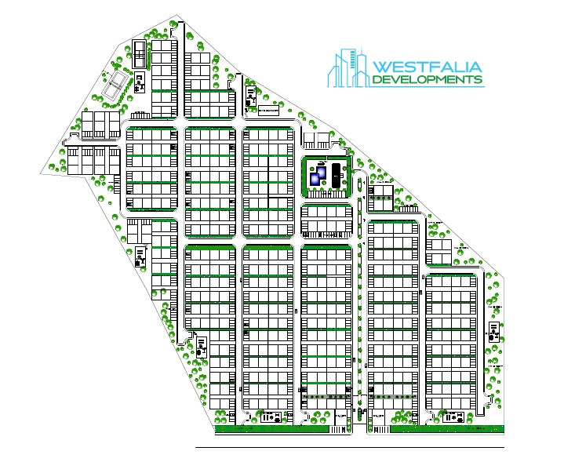
The Community:
Features
In addition to the amenities available for each individual home, all Westfalia projects will include several exciting community features for its residents:
Community clubhouse
Swimming pool
Multi-purpose courts
Community parks and trails
Commercial space for local convenience stores

Slide 8
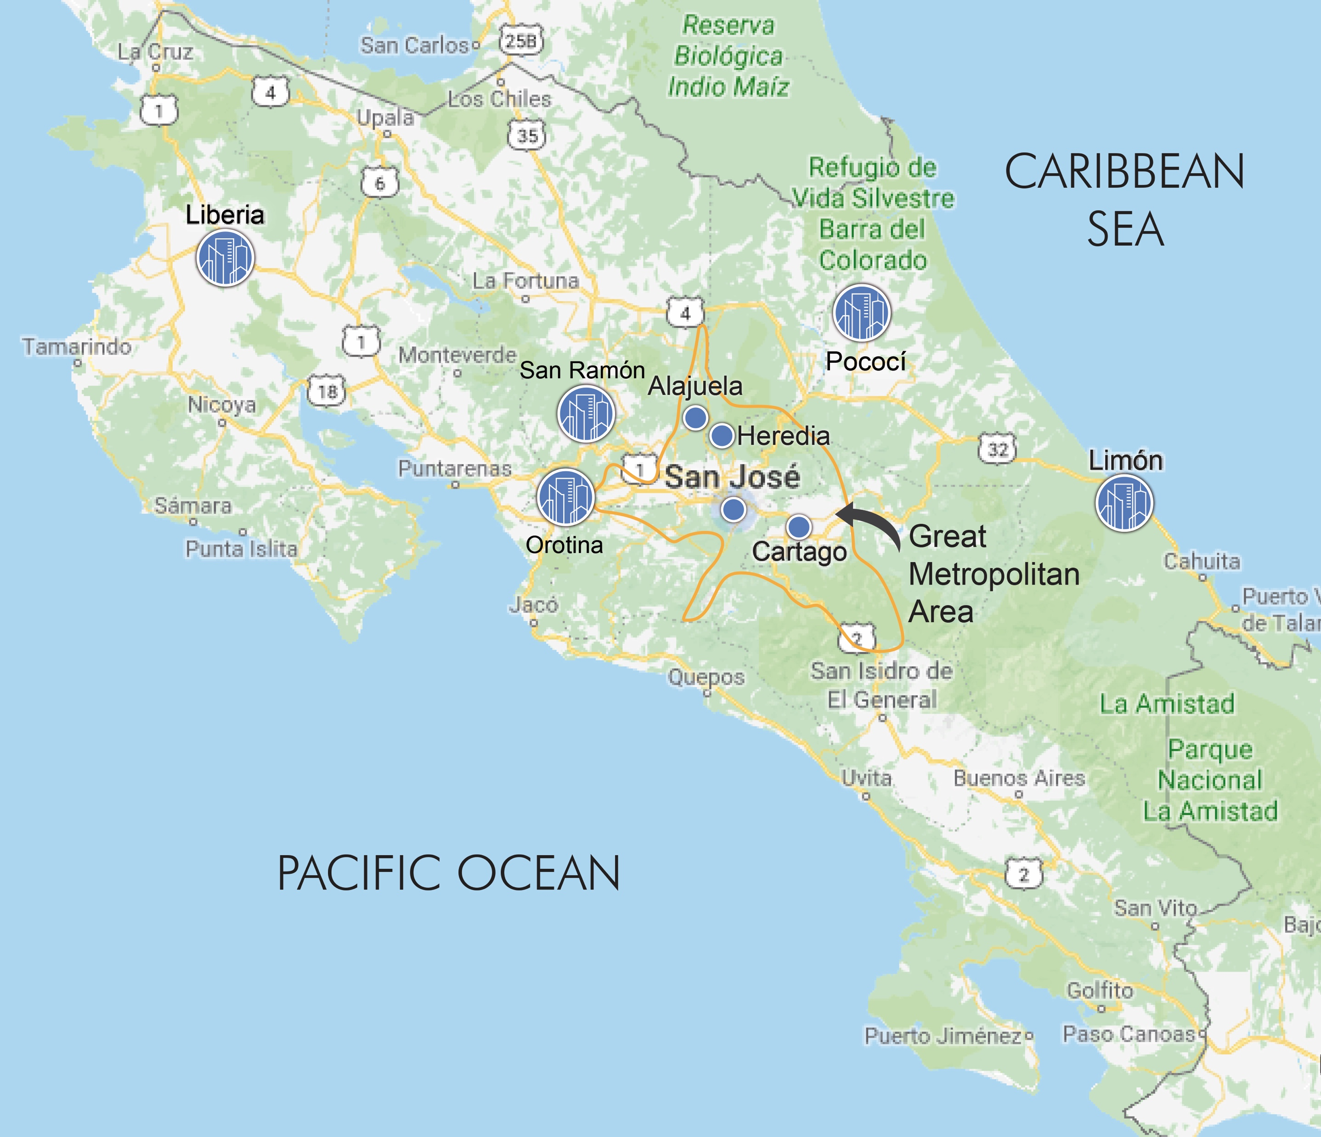
Future Westfalia
Development Sites
We have already identified 5 cities outside the San José GAM with growing populations, strong economies, and underserved housing markets. These areas will be ideal for Westfalia Development communities.
Limon
Pococi (Guapiles)
San Ramon
Liberia
Orotina

Slide 9




Our
Development Partners
To ensure a smooth development process and the most complete community experience, Westfalia has joined forces with some incredible partners.
Edica Ltd. is a building and infrastructure construction company who will work as a contractor on some infrastructure projects.
Durman specializes in piping systems and wastewater treatment.
Nassar Abogados is a regional law firm with extensive knowledge of property law and permitting.
We have also worked closely with the Chamber of Commerce Industry and Tourism of Limon (CCITUL), an organization that promotes investment in the Province of Limon, throughout our planning process.

Slide 10

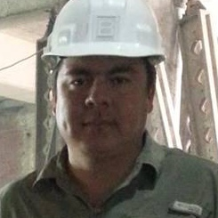

Meet
The Team
Clinton Cruickshank - Founder & CEO of Westfalia Developments
Clinton has 14 years of experience in finance and management, CSSGB and PMP. He was formerly CFO for Punta Mar de Limon, a real estate developing company.
Marco Vinicio Monge - Contractor
Marco has 20 years of experience in construction and founded MARCONSA, a construction company specializing in residential and commercial buildings.
Daniel Befeler - Legal Counsel
Daniel is a lawyer with more than 22 years of experience in commerce and property law. He’s a partner at Nassar Abogados, a San José regional law firm.

Slide 11



Randy Gordon - Advisor
Randy is a lawyer and the founder of construction and maintenance services company Servicios Pinar. He is also currently Vice President of the Limon Chamber of Commerce Industry and Tourism (CCITUL).
Clinton Cruickshank Sr. - Advisor
Clinton is a real estate agent with vast experience in the market both as a broker and an investor. He has served as a congressman and board member for various government institutions in Costa Rica.
Erick Garro - Marketing Advisor
Daniel is a lawyer with more than 22 years of experience in commerce and property law. He’s a partner at Nassar Abogados, a San José regional law firm.

Slide 12
THE REMAINING SLIDES WILL BE FEATURED ON THE PRIVATE -- OR “BUSINESS PLAN” -- HALF OF YOUR ONLINE CAMPAIGN.
ONCE YOUR PROFILE IS LAUNCHED AND LIVE, INVESTORS MUST REQUEST ACCESS TO VIEW THE REMAINING INFORMATION.

Slide 13

Meeting Housing
Market Demand
Costa Rica is currently facing a
$15.85 billion housing deficit.
For the past 5 years Costa Rica has experienced a steady growth in construction and housing, but the majority of that construction has been low income housing or homes and apartments priced above $150,000 US.
Westfalia Developments looks to focus on middle-class homebuyers. Pricing our homes between $100,000 - $130,000 US will make them accessible to 34.87% of the population.
To further differentiate ourselves from the competition, we will build in cities outside the San José Greater Metropolitan Area (GAM) where the market is significantly underserved.

Slide 14
Westfalia
Revenue Streams
Each Westfalia Developments project will feature three streams of revenue:
The Homes
Each home will be priced between $100-130k, with 60 homes sold annually.
Prices will reflect a XX% profit margin and include construction and finishing costs, developed land, and be adjusted for yearly inflation.
$100-130k
PER HOME
The Community
All development projects will be gated communities with Home Owners Association (HOA) fees.
A standard $110 per household fee will be assessed, allowing for XX% profit on community maintenance costs.
$110
HOUSEHOLD FEE
The Commercial Lease
Each community will be designed with space for commercial lease.
Lease values will vary based on market price per square meter of lease space, property type, and yearly adjustments.

Slide 15



The Competition
In Homebuilders
Calypso Developments is a company with 4 years experience and a project already in progress in Limon. However, we expect to be very successful against this project because our homes are more budget-friendly for potential homebuyers and we can offer better financing options.
CONCASA develops projects around the same price point and with similar financing options as Westfalia, but their focus is primarily in the San José GAM. This leaves most of the market outside the GAM to us.
VIVICON has significant market experience and a solid track record, but they are not a direct competitor for Westfalia. The two current projects from VIVICON are located within the San José GAM and are priced for high income homebuyers.

Slide 16
Why
Westfalia?
With such a significant housing deficit in Costa Rica, why would Westfalia Developments be the company to make an impact in the market?
The key is in our permitting procedure.
The first permit any development company needs in Costa Rica is a Use of Water permit. Outside of the San José GAM public water isn’t as reliable, so permitting becomes a lengthier process. It can normally take 1-3 years to secure this permit.
We have consulted with Costa Rican government authorities to plan the most efficient permitting process. By filing all permits jointly, we can break ground up to 3 years before anyone else.

Slide 17
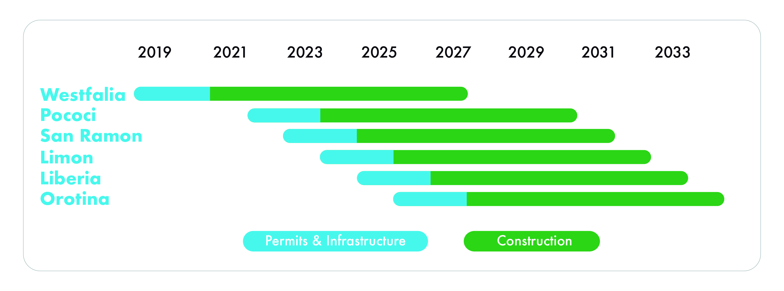
Development
Plans
Each Westfalia Developments project will consist of 370-420 houses, 2-4 commercial spaces, and community amenities on 10-12 hectares (25-30 acres) of land.
Our first project will be located in Limon where we have already identified and designed a site for 406 homes and 2 commercial spaces. We intend to begin in 2019, with delivery beginning Year 3 (2021) following a gestation period required for permitting and initial infrastructure construction.
Future projects will begin in 2022 following sufficient sales of our first project. We will begin a new project every year thereafter.

Slide 18




Homebuyer
Acquisition
Our primary method of homebuyer acquisition will be via direct sales of our sales team. They will be responsible for pre-selling homes following permit approval, working at a 5% commission.
All advertising strategies will direct interested parties to our website (westfaliahomes.com) or to our sales team phone number.
Billboards surrounding the development site
Online promotion via our website, online magazines, and home search databases
Presence at the country’s most prominent annual housing trade shows:
Print promotions via real estate magazines and classifieds
Expo Construccion
32,000 visitors
For Sale by Owner monthly distribution of 20,000 free copies
Expocasa
25,000 visitors
Property Hunters Costa Rica monthly distribution
30,000 print/39,500 digital

Slide 19
Why
Invest?
Those of us at Westfalia Developments would like to thank you for taking the time to learn about our company, our plans to provide homes in underserved Costa Rican markets, and this investment opportunity. Investors are invited to get involved with a passionate and experienced team delivering value via:
Clinton Cruickshank
westfaliahomes.com
Affordable homes for middle-class homebuyers who represent 37.78% of the market in cities outside the San José Greater Metropolitan Area.
An experienced management team with over 100 combined years in real estate, construction, and local property law.
The potential for significant ROI as Westfalia Developments aims to impact the Costa Rican housing market, which is currently facing a $15.85 billion deficit.

