Slide 1


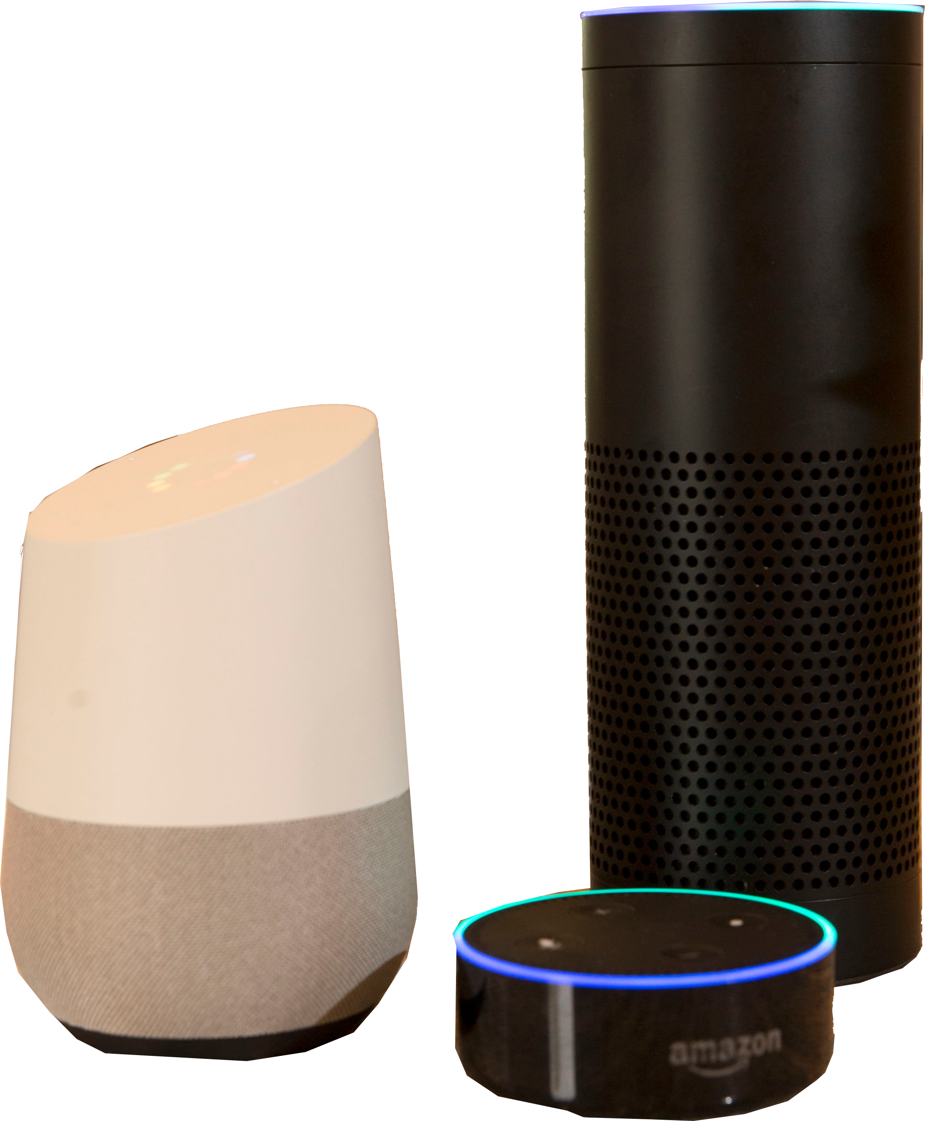


Slide 2


VOICETER PRO: FAST FACTS
Voiceter Pro is a conversational search company that operates on smart devices running Amazon’s Alexa, Google Assistant, and Microsoft’s Cortana.
Through a series of conversational questions, the voice recognition skill enables consumers to find the product or service that most closely meets their needs while simultaneously alerting the business client whose result was used. Voiceter Pro connects companies with consumers where they live - at home!

Slide 3




KEY HIGHLIGHTS
Proven Real Estate search skill with over 2,000 total sessions in first year and over 3,500 sessions for My Home Value skill in first 3 months
Numerous press mentions and Inman Innovation Award finalist 2017
Current clients include several real estate firms and 4th largest Multiple Listing Service in US and real estate agents using product My Home Value
KEY INDUSTRIES
Advertising/Sales & Marketing; Real Estate
MARKET
SIZE
30MM+ Voice Recognition Devices
TARGET
CUSTOMER
Users of Amazon Echo, Google Home, Microsoft Cortana

Slide 4
VOICE RECOGNITION DEVICES ARE COMING
Consumers are upgrading their homes with smart devices like the Amazon Echo, Google Home, or Microsoft Cortana-enabled devices.
Voice recognition device sales are projected to exceed
57 million units by the end of 2018.
These devices are helping users automate their homes, organize their schedules, purchase products and answer questions. Consumer behaviors will change rapidly and move towards using these devices for everyday activities. Their assistance is always there and only a quick question away.
Connecting consumers with the perfect product or service should be just as easy.

Slide 5

ASKING THE RIGHT QUESTIONS
Voiceter Pro is a smarter way to find products.
With a simple command, consumers can activate the Voiceter Pro conversational search skills and be guided through the product selection process from their couch.
Instead of filtering through endless websites or visiting a bunch of stores, consumers can now receive top results with just a few answers. Voiceter Pro clients receive lead information to follow up with interested consumers.

Slide 6
HEY, VOICETER PRO…
The various Voiceter Pro skills are launched on voice recognition devices by using the proper wake words or phrase.
“Alexa, open Real Estate” or “Hey Google, open Real Estate search”
Then the Voiceter Pro skill asks a series of conversational questions to better understand preferences and narrow the search.
“Where do you want to live?”
Once the questions are answered, the top three results are voiced and emailed to the user. The business whose result was listed is also alerted to a new lead.

Slide 7


PRESS AND PARTNERS
Voiceter Pro has already seen significant traction in the first year. In addition to multiple press mentions from Street Fight, Capital District Business Review, and Realtor Magazine, to name a few, Voiceter Pro was also nominated as an Inman Innovator Award finalist and was invited to Realogy FWD to present as a leader in voice technology.
Some of our partners include Berkshire Hathaway HomeServices Georgia Properties, several Real Estate brokerages, and the Multiple Listing Service of Long Island - the 4th largest listing service in the U.S.

Slide 8







WHAT’S AFTER REAL ESTATE?
Voiceter Pro skills currently reside solely within the real estate industry, but already they show their versatility.
Real Estate/Real Estate Search - search for listings in the area
Real Estate Careers - expand your career, get in touch with interested brokerages
Real Estate Concierge - connect buyers and sellers with trusted service & repair providers
My Home Value - find your home value… and an agent!
REBI - created a customized promotional skill for the Real Estate Business Institute
White label - solutions on demand
Echo Show – positioned to capitalize on the evolution of Amazon products
The conversational search process could be developed to similar effect for car buying, insurance, mortgage, furniture, and clothing. We also can collaborate with other Tech companies to help them find their voice solutions.

Slide 9


THE LEAD INNOVATORS
Miguel Berger - Chief Executive Officer - With more than 30 years of experience in the real estate industry, Miguel is the owner of Better Homes and Gardens Real Estate Tech Valley franchise. He founded the successful company as an independent brokerage in New York State’s Capital Region before he became affiliated with Better Homes and Gardens Real Estate. In addition to holding several advanced real estate designations, Miguel has been a local REALTOR® association and multiple listing service president. He is recognized nationally as an industry leader and forward thinking business man with a love of technology. He will become president of the national Real Estate Business Institute in 2018.
Amitai Berger - Chief Technology Officer - Fluent in several programming languages, including Java, Ruby on Rails, Python, CSS, XpressO and AWS, Ami has wide and varied experience that includes developing software for both startup and established companies. His skills include leading a team of developers through product development and testing cycles focused on end-user experience improvements and working on APIs used by tens of thousands of users on a daily basis. He has been working in voice technology since mid-2015.

Slide 10



THE ADVISORY BOARD
Tim Dain - Tim is the current President of MARIS Multiple Listing Service (MLS), as well as a board member for both the Council of MLS and the Real Estate Standards Organization. He served as Executive Director of the Austin Board of Realtors. He was Executive Director of the Southern Illinois Regional MLS (SIRMLS) where he was responsible for creating a virtual presence.
Amy Chorew - Amy has more than 30 years’ Real Estate experience. Since 2000 she has been on the speaking circuit teaching industry professionals about technology strategies to help improve their business. She has written four books on social media for the National Association of REALTORS® (NAR), co-authored the NAR e-Pro® certification for social media use, and is the founder and former CEO of The Tech Byte, an education company specializing in coaching real estate firms about technology in their day-to-day operations.
Warren Dow - Warren is the Vice President of Industry Engagement at Lone Wolf Real Estate Technologies as well as an ongoing contributor to the Real Estate Technology Institute (www.reti.us). Prior to being acquired by Lone Wolf, Warren was the Vice President and Co-Owner of Barcode Publicity, one of the real estate industry’s premier website solution providers with a core focus in mobile technology and technology education.

Slide 11
THE REMAINING SLIDES WILL BE FEATURED ON THE PRIVATE -- OR “BUSINESS PLAN” -- HALF OF YOUR ONLINE CAMPAIGN.
ONCE YOUR PROFILE IS LAUNCHED AND LIVE, INVESTORS MUST REQUEST ACCESS TO VIEW THE REMAINING INFORMATION.

Slide 12


A SMARTER WAY TO ENGAGE CONSUMERS
Adoption of artificial intelligence powered virtual assistants, such as the Amazon Echo and Google Home, is expected to increase five-fold within the next five years.
Estimated sales of the Amazon Echo and Google Home are expected to exceed 57 million units by the end of 2018.
Consumers are looking to make their homes smarter, and businesses can leverage that desire with Voiceter Pro. Product and service searches can now happen with a simple question instead of hours searching online or visiting multiple stores. Consumers can find a new home from the comfort of their couch or while making dinner.

Slide 13
SKILLS PRICING STRUCTURE
The Voiceter Pro virtual assistant skills could be developed for numerous industries, but current offerings were developed with the real estate industry in mind.
Real Estate Search
$XX+
PER MONTH
Real Estate Careers
$XX-$XX
PER MONTH
FOR EACH ZIP CODE
Real Estate Careers
$XX
PER MONTH
(INTRODUCTORY PRICE)
My Home Value
$XX-$XX
PER MONTH
FOR EACH ZIP CODE
White Label Solutions
$XX+
PER MONTH
No other virtual assistant skill is currently monetized in the Real Estate space.
Future skills for other industries would be priced accordingly based on market size.

Slide 14
PROGRESS REPORT
Voiceter Pro revenues currently total $16K/month across our suite of real estate skills. We expect revenue to increase exponentially once we begin marketing.
Seven real estate firms use our Real Estate Search ($XXK)
Multiple Listing Service Long Island--4th largest MLS in the country--is subscribed to our Real Estate Search and Real Estate Careers skills ($XXK)
Nearly 50 real estate agents subscribe to What’s My Home Value at $80/month ($XXK)
Revenue Projections

Slide 15
User access for our skills total over 5,000 sessions.
Skill Name | Type (Alexa/Google) | Users | Sessions | Date Range
Real Estate | Alexa | XX | XX | 4/2017 – 12/2017
Real Estate Search | Google | XX | XX | 5/2017 – 12/2017
Real Estate Careers | Alexa | XX | XX | 6/2017 – 12/2017
Real Estate Careers | Google | XX | XX | 7/2017 – 12/2017
Tech Valley Concierge | Alexa | XX | XX | 8/2017 – 12/2017
My Home Value | Alexa | XX | XX | 10/2017 – 12/2017
What's My House Worth | Alexa | XX | XX | 10/2017 – 12/2017
My Home Value | Google | XX | XX | 11/2017 – 12/2017
What's My House Worth | Google | XX | XX | 11/2017 – 12/2017
REBI | Alexa | XX | XX | 11/2017 – 12/2017
Tech Valley | Alexa | XX | XX | 12/2017 – 12/2017

Slide 16



A GLANCE AT THE COMPETITION
Voiceter Pro is not the only real estate skill available for voice recognition virtual assistants, but it is unique in its successful monetization. Additionally, it is the most versatile and intuitive option in the market.
The skill My Agent/My Realtor only identifies the number of listings in the area. It doesn’t narrow the search based on user preferences and it isn’t user friendly.
Agent NEO provides a good consumer experience and connects users with real estate agents, but it was developed without real estate experience and lacks the industry data.
One other skill was very focused on consumer experience and even used Watson Technology from IBM, but Ask DOSS appears to have ceased operations.

Slide 17



ENHACING OUR SKILLS
With the success Voiceter Pro has already achieved, our current goals are to enhance our skills within the real estate industry.
We are constantly evaluating our own skills, monitoring market development to arrive at real world skills that demonstrate value to consumers.
A new skill specifically designed for finding a real estate agent would help round out our portfolio, while a reworking of our first virtual assistant skill, Real Estate Search, would result in a smoother user interaction and allow us to include home values.
Our other projects include white label skill solutions for the Mohawk Hudson Humane Society and a metropolitan real estate franchise.
Should significant interest continue to grow in our suite of real estate virtual assistant skills, we expect a firm could show interest in purchasing exclusive rights or our company.

Slide 18

OUR FUNDING SEARCH
Voiceter Pro is seeking funding of
$XX in convertible debt at a XX% discount.
This funding will expand the Voiceter Pro team with additional software engineers who will begin development on skills in verticals outside of the real estate industry. We will also bring on a chief operating officer as we pursue a more aggressive growth strategy.
2%
IT Infrastructure
3%
IT Security Consulting
23%
Marketing
45%
Software Engineers and Web/App Developer Personnel
7%
Data Normalization/Handling Fees
20%
Administration and Marketing Personnel

Slide 19






IN CONCLUSION
The Voiceter Pro team would like to thank you for taking the time to learn about our company, our virtual assistant skills, and this investment opportunity. Investors are invited to get involved with a knowledgeable and innovative team delivering value to investors via:
A smart, conversational search skill that connects businesses and consumers through virtual assistants Amazon Alexa, Google Assistant, Microsoft Cortana and emerging platforms.
An experienced executive team with decades of experience in the Real Estate vertical necessary to launch a successful technology business.
The potential for significant ROI from the only monetized virtual assistant skill currently available for the real estate industry.
Miguel Berger, CEO | www.voiceterpro.com

