Slide 1
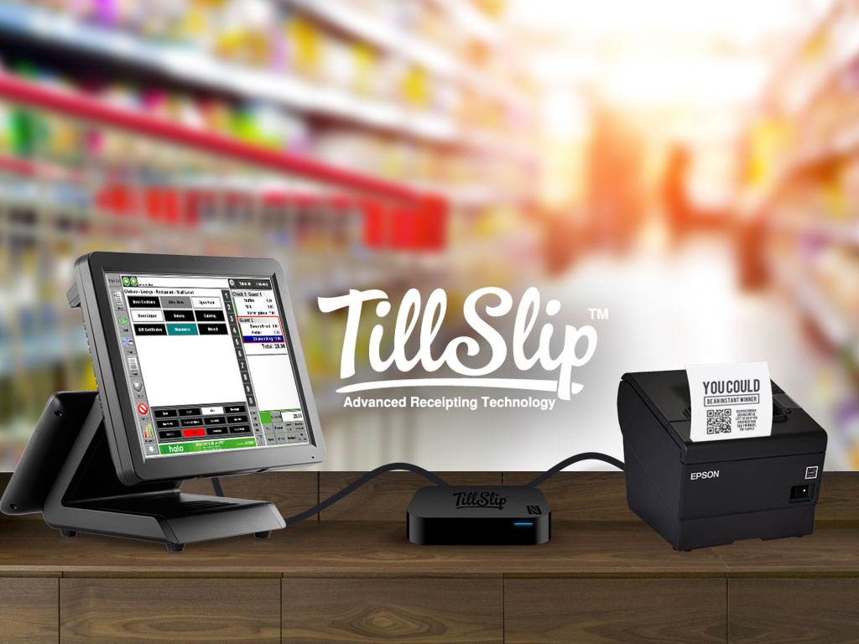

Slide 2
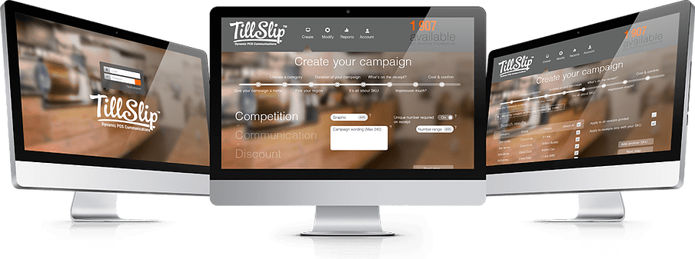
TillSlip: Fast Facts

Slide 3

TillSlip is an advanced receipting technology that reads and interprets receipt data in real time. Based on a consumer’s purchases, brands and retailers can instantly target consumers with coupons, rewards, or contests that are printed directly onto the receipt. The augmented receipt can also be stored digitally to
a customer’s personal account for financial records.

Slide 4

Key Highlights
Each TillSlip device is plug-and-play ready, allowing for implementation at any point-of-sale.
Brands and retailers can create hyper-targeted campaigns based on real time analytics for far less than other forms of media, or advertising agencies would charge.
A trial conducted in partnership with SAB Miller showcased TillSlip ability to significantly increase sales and customer engagement.
The TillSlip device and solution is patent-pending in South Africa and PCT (154 Countries).
Industry
Retail Advertising/
Marketing / Research & Big Data
Market Size
Multi-Billion Potential
Target Customer
Retailers; Brands

Slide 5
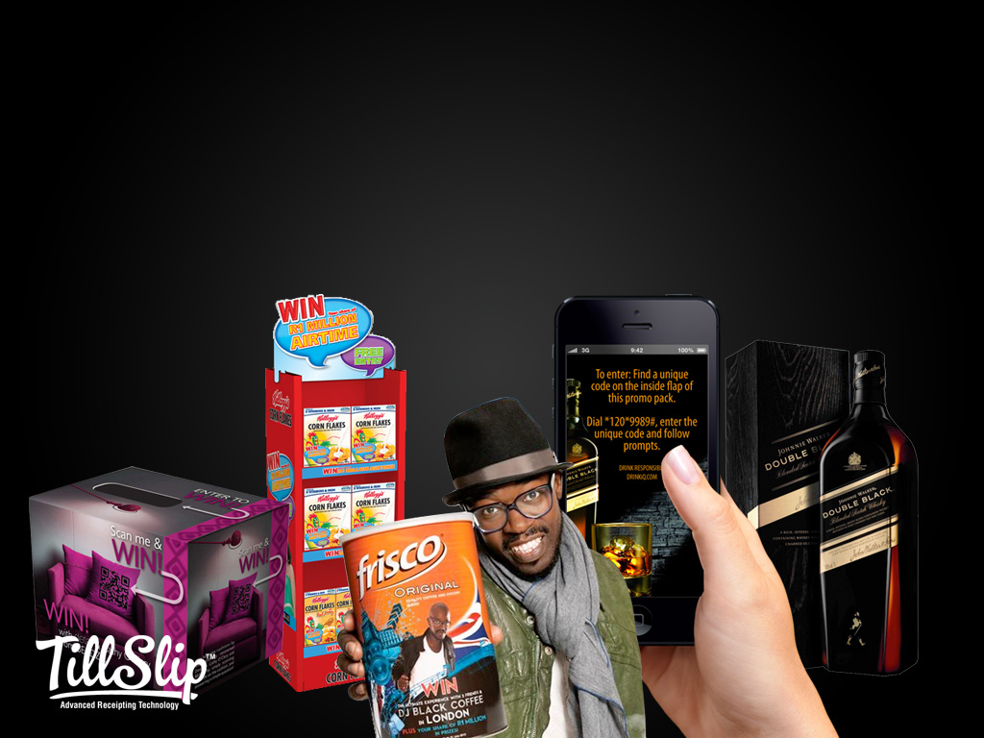
Marketing in today’s digital world is harder than ever. Push emails are deleted before opening, mass campaigns are completely ignored, and display ads have less than 6 seconds to catch someone’s attention.
Consumers want to feel understood. They only want ads for the things they’ll use.
Data analytics has become the golden tool to better understanding consumers. Digital activities such as search habits, purchase history, and social media all help brands and retailers to target specific groups and create a customized retail experience.
What if the same data could be collected from traditional brick and mortar point-of-sale?

Slide 6
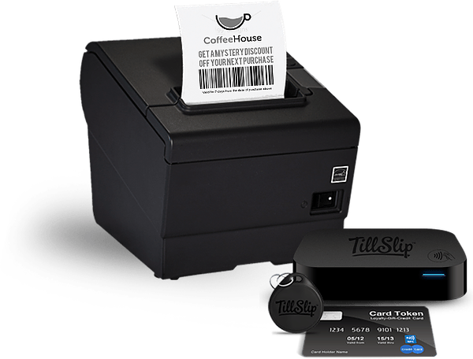
EVERYTHING IS ON THE RECEIPT
TillSlip is an advanced receipting technology
that provides brands and retailers with comprehensive data analytics and targeting power, while also providing consumers with only the promotions and ads that are relevant to them.
Receipts are key to better understanding consumers in traditional brick-and-mortar stores. Globally every point-of-sale generates receipts (4 billion daily!), and by analyzing that data in real time brands and retailers could provide individualized targeting to any person, in any store…with huge data possibilities.

Slide 7
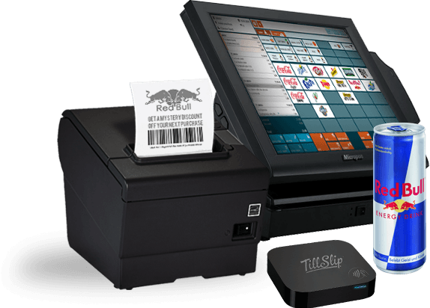
TillSlip Transforms Receipts
tillslip transforms receipts

Slide 8
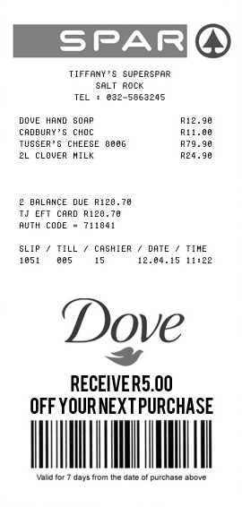
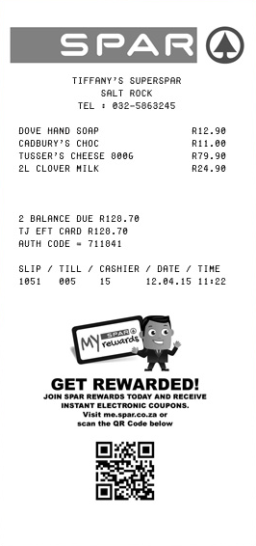
TillSlip turns passive receipts into active customer engagement channels. Advertising is printed on a physical or digital receipt based on the client’s purchases. This enables retailers and brands to communicate with their customers, build loyalty, and drive sales.

Slide 9
Plug & play
CONNECTED
PERSONALIZED
Compatible with any point-of-sale without complicated installation or integration.
Internal GSM and onboard memory make TillSlip cloud-based and up-to-date.
Every TillSlip receipt is printed with only the ads, promotions, or contests that are relevant to a customer’s purchases.

Slide 10
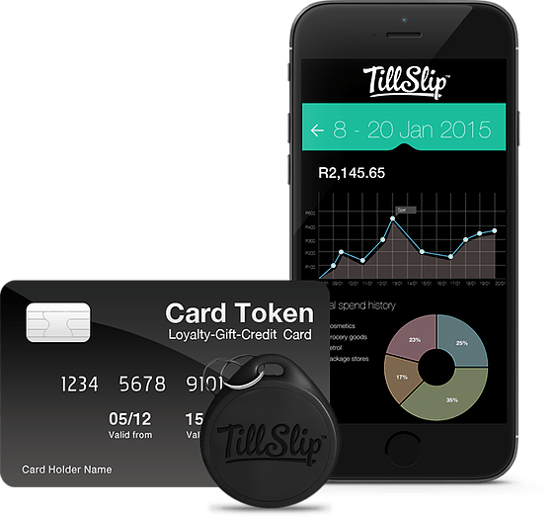


tillslip transforms receipts
TillSlip gives customers the ability to further personalize their shopping experience through our app. Our app allows digital copies of receipts to be stored in personal accounts to build purchase history profiles and so much more.
easy
Each receipt can be added instantly to a customer’s account via SMS, email, or NFC app connection.
QUICK
No need to log on to a computer when customers can interact directly with social media links, surveys, or product recommendations on their digital receipts.
RESPONSIBLE
Expenditure tracking becomes a breeze with searchable records of receipts.
Informative
Expenditure tracking becomes a breeze with searchable records of receipts.

Slide 11
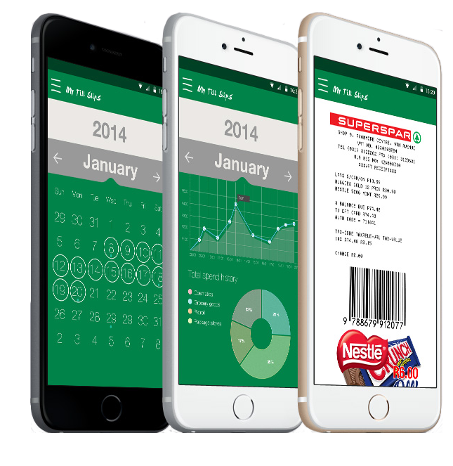
tillslip ANALYZES receipts
TillSlip enables the creation of hyper-targeted and personalized campaigns through real time data analysis. Campaign creators can gain insights across all levels of their campaigns with this data.
Create - Effortlessly design national or regional campaigns based on SKU, combination, or total basket purchases on the TillSlip online dashboard.
Communicate - Share promotions, contests, QR codes, etc. anywhere on the receipt to increase customer engagement.
Customize - Access our campaign creator platform on any device to view analytics reporting and insights that can help you tweak your campaign.

Slide 12
A Case Study with TillSlip
A CASE STUDY WITH TILLSLIP
TillSlip has already complete a successful trial in partnership with SAB Miller.
A number of devices were integrated at SPAR retail stores in South Africa, and if a customer purchased any SKU variant of a SAB Miller Castle Lite 24-pack the TillSlip device printed a contest entry on the receipt.
Consumer engagement increased by 86% in two just two months.
Sales of Castle Lite increased by 24% in the same time period.
We have letters of intent from SAB and Unilever, and also received numerous requests for national/ large scale trials from the large FMCG brands and retails chains.
Consumer engagement increased by 86% in two just two months.
Sales of Castle Lite increased by 24% in the same time period .
We have also received an offer from Unilever for a large scale trial.

Slide 13

THE tillslip TEAM

Slide 14



Pravir Seevnarayan – CEO
As a path builder, I’ve always enjoyed developing solutions to complex challenges. Being the head of Lylax Bedding / Serta Africa for 15 years, I have learned the complexity of trading across 9 countries whilst servicing 3000 stores across a multitude of cultural differences. Being instrumental in design and implementation of manufacturing, sales, operations, and marketing strategies, I’ve, learned importance of efficacy, efficiency and culture when developing these solutions…
Justin Raleigh - COO
I believe in challenging the status quo, especially within the marketing industry where I have spent most of my professional life. I am a specialist on consumer and loyalty behavior and am able to help tap those powers for our clients.
Kamlesh Ranchhod - CFO
Making financial sense is common sense to me. I am an experienced trader and financial accountant, as well as a business owner of 10 years. I am savvy about making business sense and focused on the financials of TillSlip.

Slide 15

ENGAGE RETAIL MARKETING
EVERYWHERE
The average brand or retailer will spend up to
But unlike e-commerce, traditional brick-and-mortar stores don’t have easy ways to analyze market trends. Many companies have instituted costly loyalty programs to engage customers and measure their spending, but those loyalty programs end at the store doors.
20.0%
of its annual budget on retail marketing
This money is used for everything from advertising, strategy to market research.

Slide 16
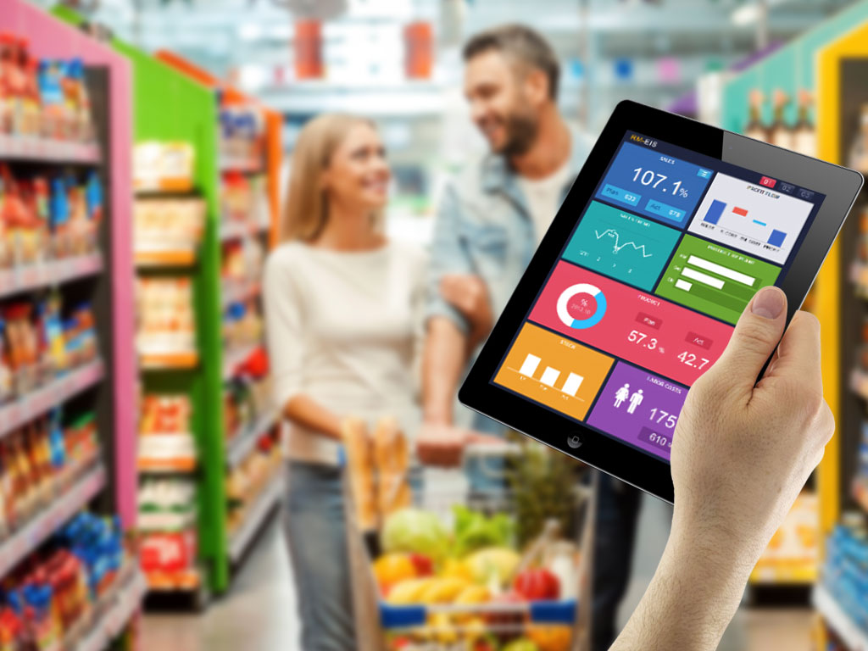
TillSlip is an advanced receipting
technology that analyzes transaction
data at any point-of-sale, anywhere in
the world and prints relevant ads or
promotions on customer receipts. This allows brands and retailers to communicate with their customers in any store and enables them to create targeted campaigns based on multiple data sources.

Slide 17

NUMBER OF DEVICES IN OPERATION | 12,500
Impression Income
Revenue per impression | $0.04
Less: retailer/agency commissions | $0.01
GROSS REVENUE: | $0.03
Impressions sold daily per device | 40
Monthly impressions sold per device | 1,200
Number of Devices | 12,500
GROSS REVENUE PER MONTH | $392,308
PRICING
&
Revenue
model

Slide 18
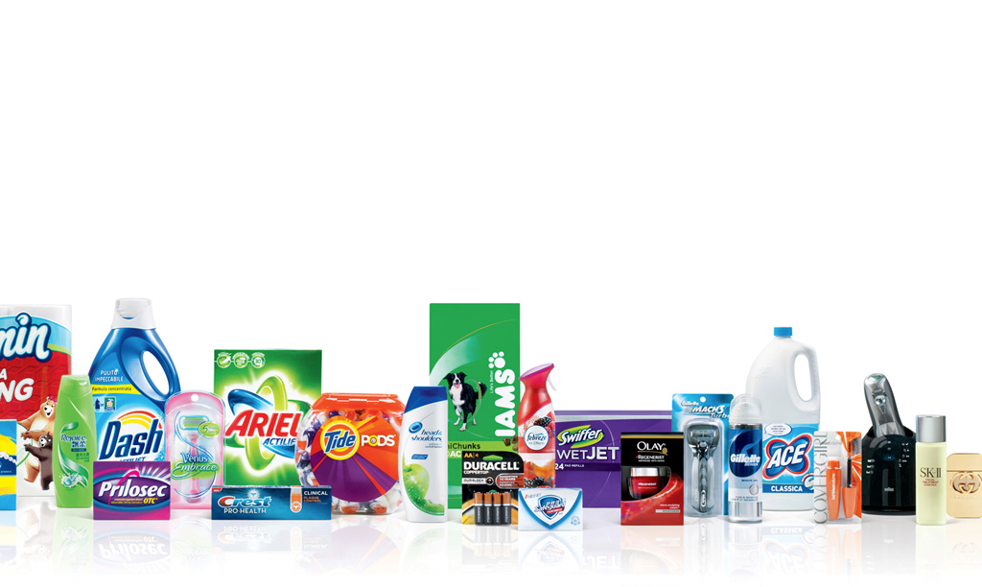
TillSlip revenue will be generated on a “per impression” basis.
We will sell eg. $40 bundles of 1,000* impressions to brands and retailers. Based on our first-tier goal of 40 impressions printed daily at 12,500 TillSlip points-of-sale across South Africa, we estimate monthly net profits of
$250,108 for South Africa only after 6 months
We will also develop pricing plans for 3rd party access to data analytics as the number of active TillSlip devices increases.

Slide 19
TILLSLIP
OUTPERFORMS
THE
COMPETITION
There is no solution
like TillSlip.
Our closest competitor is Zapper, a mobile payment and digital marketing app that allows brands and retailers to push personalized vouchers, reviews, and bills directly through the app based on previous purchases. But Zapper only works in select stores, and only draws data from people who use the app.
TillSlip is plug & play with every point-of-sale.
It also analyzes every receipt, enabling brands
and retailers to engage any customer at any store.

Slide 20
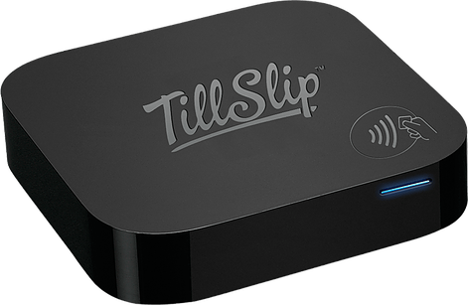
Final
Development
Steps
Our trial with SAB Miller proved the effectiveness of the TillSlip device, but there are some aspects of the total TillSlip solution we want to perfect.
NFC Identification
Customer E-receipt App
TillSlip devices are already NFC capable, but we still need to develop the peripheral receiver that will allow customers to be identified with a tap of their phone, keytag, or loyalty card.
Along with customer identification via NFC, we still need to develop the app that will allow customers to view, organize, and interact with receipts on their phone.

Slide 21

We are seeking
$XX
for a XX% stake
in our company
with no minimum investment and no valuation cap. The stake would grant full rights to the TillSlip solution and corresponding use of its intellectual property in all 54 African Countries. This would also include any revenue from the sales of Big Data for this territory. Rollout to begin in South Africa and our strategy to cover at least 70% of the territory in 5 years.
We conservatively estimate a return on investment of 35 - 50% per annum after 3 years.
In addition, we are actively seeking qualified individuals to provide insight and expertise on the TillSlip team as we launch locally and globally.

Slide 22
The TillSlip team would like to thank you for taking the time to learn about our company and this unique investment opportunity. We’re now inviting investors to get involved with a driven, innovative team delivering value to shareholders via:
Equity in a unique retail marketing solution
that is flexible and offers enhanced retail interactions for both merchants and customers.
The potential for significant ROI
as TillSlip continues to expand within South Africa and other African nations.
Active participation in TillSlip growth
as the leadership team seeks invaluable expertise and insights from qualified individuals in the coming years.
Pravir Seevnarayan, CEO | www.tillslip.com

