Slide 1
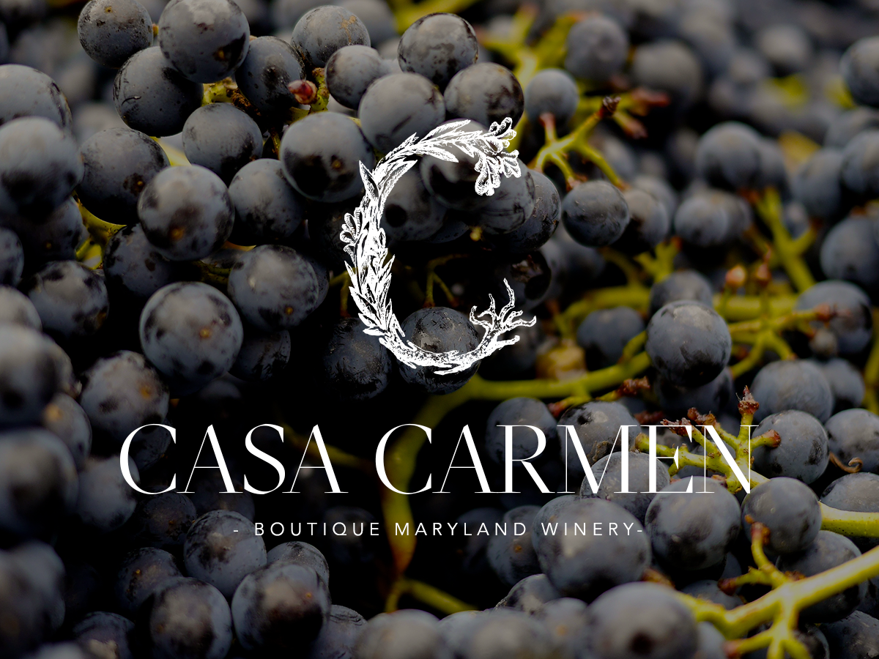

Slide 2
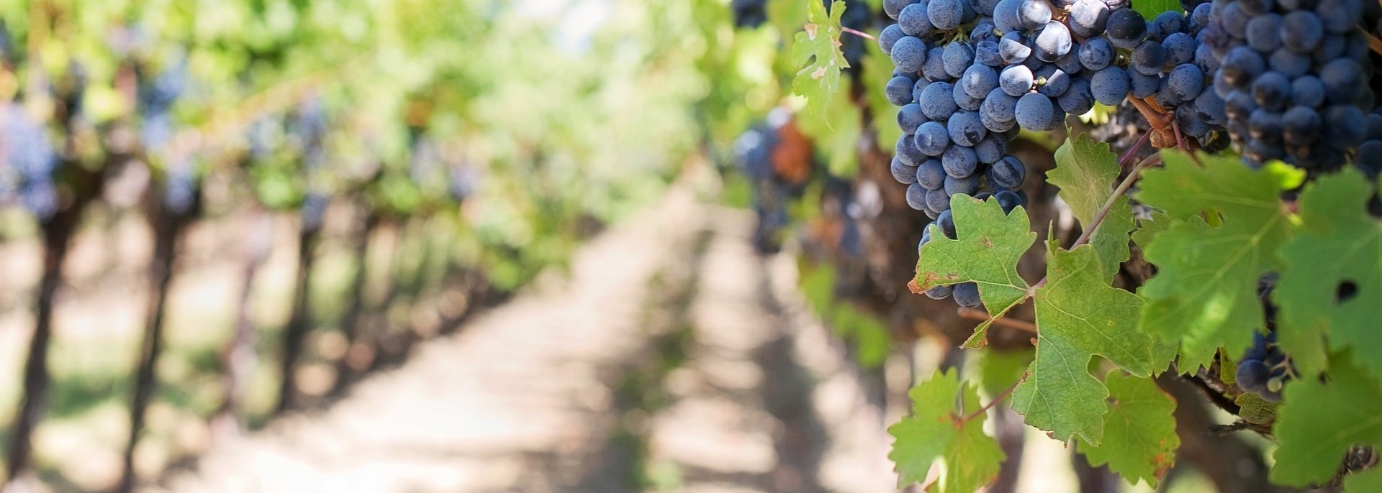
Casa Carmen: Tasting Notes
Casa Carmen, Inc. is a old-world style, boutique winery in Chestertown, Maryland that specializes in premium, local, dry wines. Just a short drive from Washington, D.C., Annapolis, Baltimore, and Philadelphia, our winery is perfectly situated along the Chesapeake Wine Trail on a historic farmhouse property. Casa Carmen aims to deliver not only world-class wine, but also a unique winemaking experience that enhances the local culture and community.
Key Highlights:
Strategically located winery on historic farm (circa 1847) along the Chesapeake Wine Trail.
White and Red 2017 vintages already harvested and fermenting.
Expert winemaker with a proven record of over 23 wines rated 90+ points, including two wines rated 100 points by Robert Parker
Unique style of wine not currently produced by nearby Maryland wineries.
Industry: Maryland Wines
Market Size: $2.9 billion
Target Customer: Millennials, Baby Boomers

Slide 3


The Maryland Wine Renaissance
Maryland is in the midst of a wine renaissance.
By 2010 there were only
10 wineries in the state.
Currently there is over 80 wineries.
This is because the industry has been able to flourish after the Maryland Winery Modernization Act (2010) removed key legal obstacles that had previously hindered its development. While farmers and winemakers are capitalizing on Maryland’s great growing conditions, the market still has plenty of room for local vintages.
Only 3% of wines consumed in Maryland are made by local wineries.

Slide 4
Casa Carmen: A Local, Boutique Winery
Casa Carmen, Inc. aims to become a boutique producer of local, dry wines in the Chesapeake Bay region. In order to achieve that goal, we are committed to delivering:
1
2
3
Excellence
Nuance
Responsibility
Relentlessly committed to quality
Carefully crafted old-world style wines that reflect balance, complexity and character
Create long term value for investors by having a financially successful business.
4
5
Authenticity
Local
Mi casa es tu casa. (My house is your house ~ in Spanish)
Committed to working with farmers and wineries in our community to ensure the success of the future of the Maryland wine industry.

Slide 5

Finding a Home for Casa Carmen
Founding brothers Enrique and Felipe Pallares first learned to appreciate wine from their father when growing up in Ecuador:
Good wine was to be enjoyed with good food and family.
That was what made it great.
As the two brothers traveled the world, living from Argentina, California, and Spain, they began to dream of owning their own winery. They wanted a place where they could focus on quality and share with a community that appreciated wine the way they did.
It is their hope and pleasure to bring this wholesome way of life to the beautiful shores of Chesapeake Bay.

Slide 6
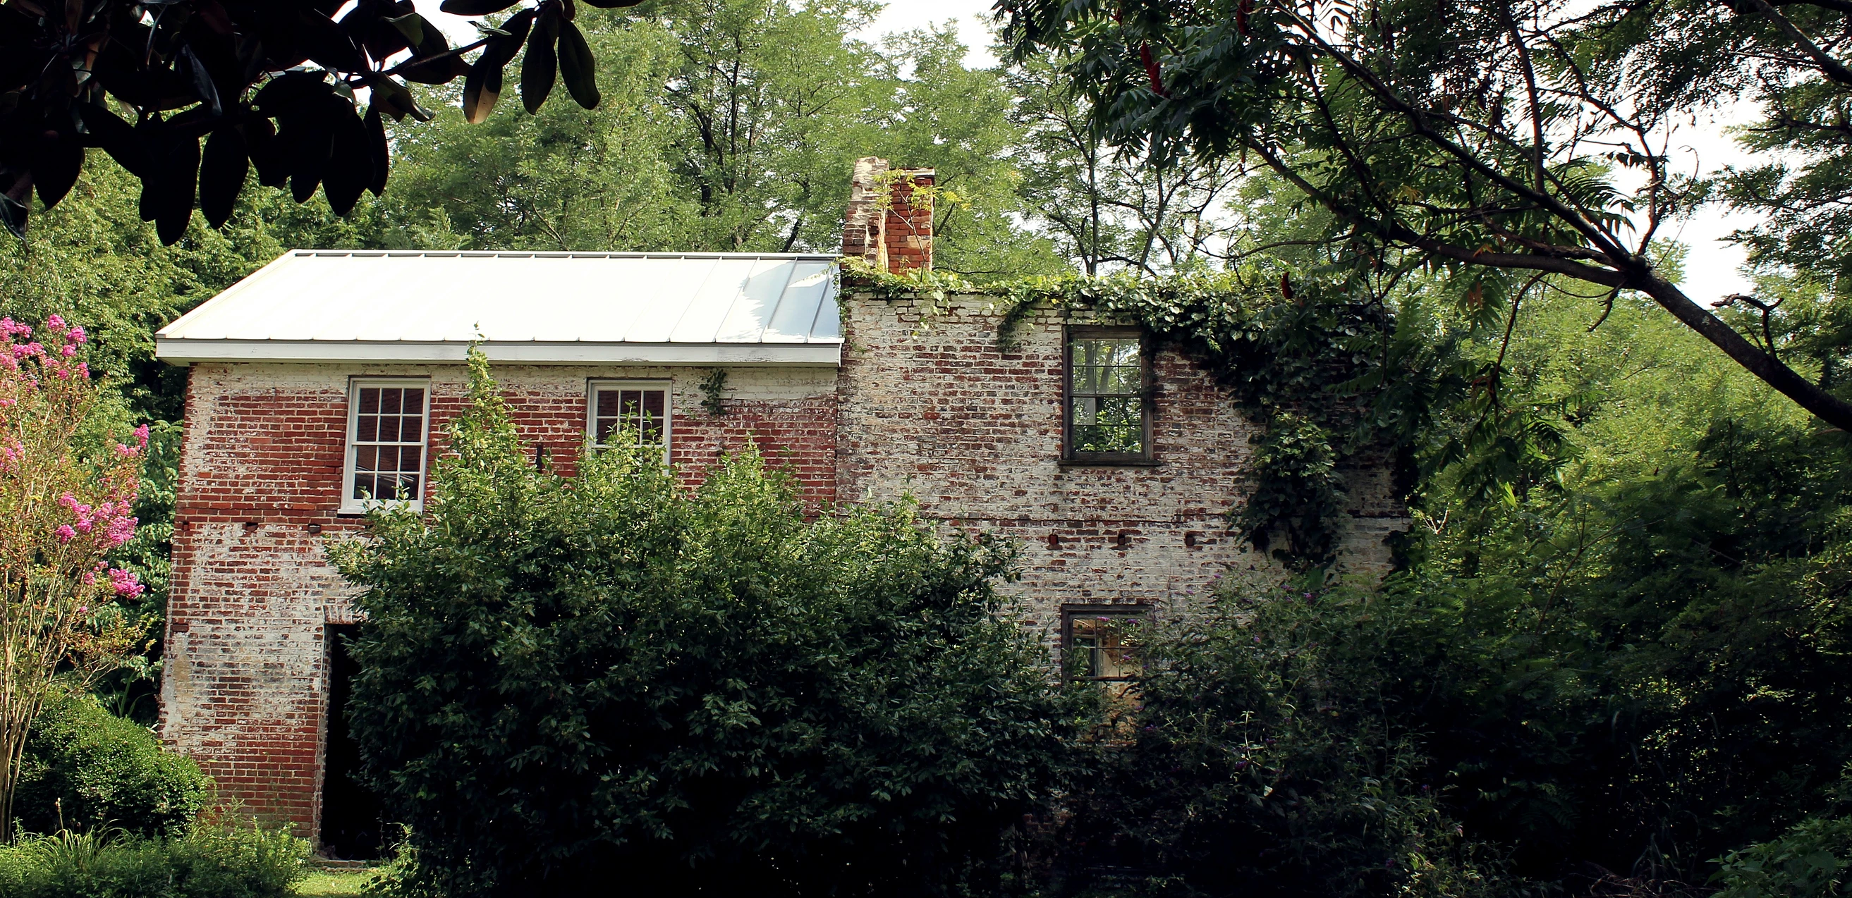
The Winery and Vineyard
At the turn of the new year Enrique and Felipe purchased the property that would house Casa Carmen. They enlisted S&P Architects to conduct an historic renovation on the farmhouse and almshouse, with a grand opening planned for Summer 2019.

Slide 7
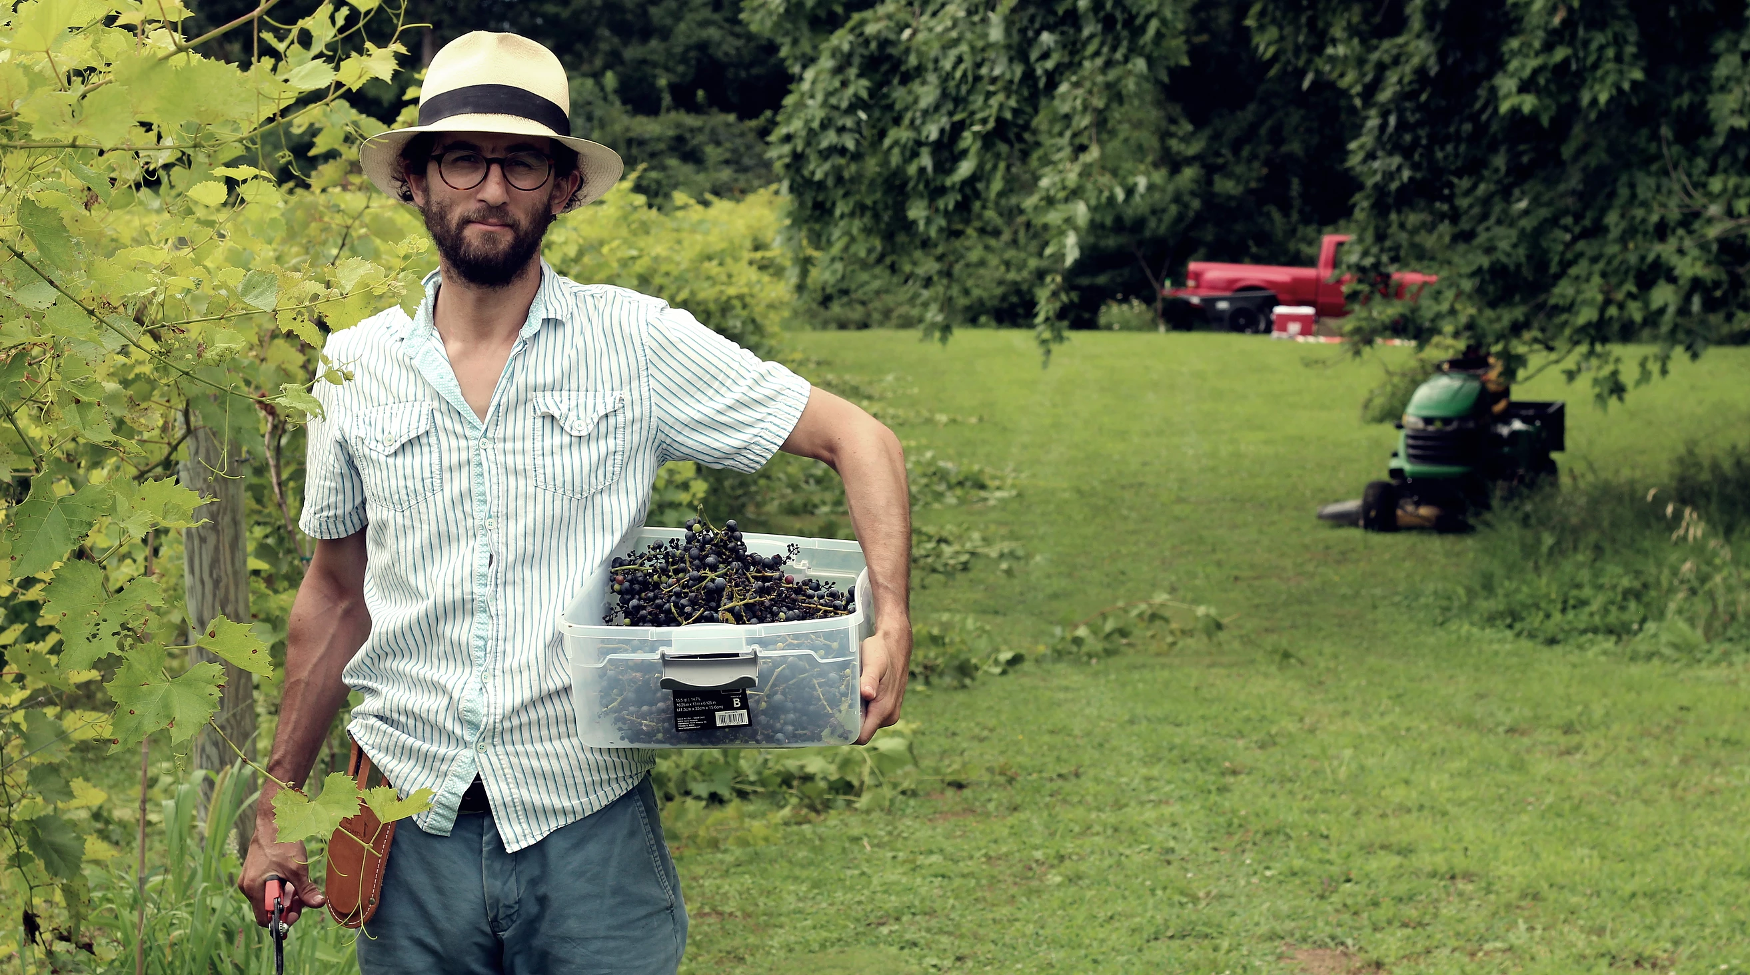
In the meantime, we’ve already harvested our first crop of grapes. We are currently producing a white blend of Gruner and Sauvignon Blanc, a red blend of Cabernet Sauvignon and Merlot, and a rosé blend of Cabernet Sauvignon and Merlot, which will be ready for Summer 2018.

Slide 8





Wine Associates and Partners
Casa Carmen has quickly integrated itself into the community as a member of several wine associations:
Maryland Wineries Association
The Maryland Grape Growers Association
The Chesapeake Wine Trail
The Vintage Atlantic Wine Region
Upper Eastern Shore Wine Trail
We’ve also begun partnerships with other local wineries to promote the region’s craft and ensure production of wines unique to each winery:
Crow Vineyards
Broken Spoke Vineyard and Winery

Slide 9
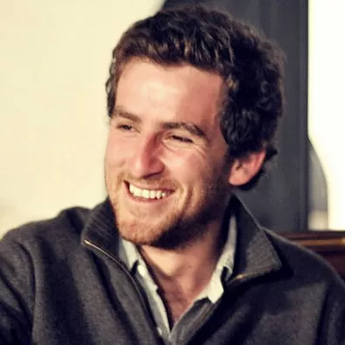
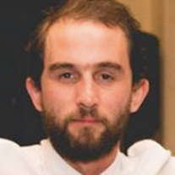
Meet The Team
Enrique Pallares - President/Proprietor
Enrique traveled the world as a professional polo player before founding Pallares Polo, Inc. with his brother, Felipe. He developed significant experience in public relations, sales and marketing in that role, but his love of wine eventually led him to co-found Casa Carmen, Inc.
Felipe Pallares - Director/Proprietor
Felipe co-founded Pallares Polo, Inc. with his brother, Enrique, and has worked towards providing high-end customer service and management in the polo and equestrian industries for 15 years. Felipe went on to study viticulture in Sonoma County, California and work at Kendric Vineyard before co-founding Casa Carmen, Inc.

Slide 10
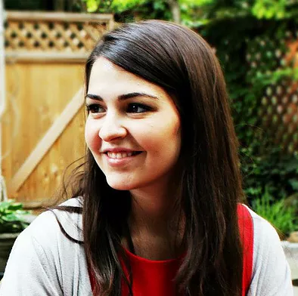
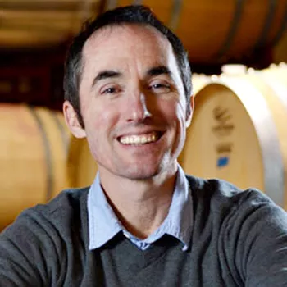
Laura Pallares - Associate Director
Laura brings experience in branding, marketing, and brand development to her role at Casa Carmen, Inc. Her previous positions include Associate Consultant at American Philanthropic--where she assisted charitable foundations and nonprofit organizations improve their effectiveness--and founding Program Director of a national educational nonprofit.
John Levenberg - Winemaker/Consultant
John obtained his Masters in Viticulture & Enology from UC Davis and spent the previous nine years working at wineries in California, France, and New Zealand. His accomplishments include the first L’Absolut de Quinault--rated as one of three best 2002 vintage wines in Bordeaux, France--and 23 wines rated 90+ points for Paul Hobbs Winery in California, including two 100-point wines.
Brian Dickerson - Viticulturist/Consultant
Brian is a proven producer of some of the best grapes in the East Coast. In addition to managing the health of Casa Carmen vineyards, he is also manager of Dickerson Vineyards, Chateau Bu-De, and Quinine.

Slide 11
THE REMAINING SLIDES WILL BE FEATURED ON THE PRIVATE -- OR “BUSINESS PLAN” -- HALF OF YOUR ONLINE CAMPAIGN.
ONCE YOUR PROFILE IS LAUNCHED AND LIVE, INVESTORS MUST REQUEST ACCESS TO VIEW THE REMAINING INFORMATION.

Slide 12

Market Opportunity
The Maryland wine industry is currently worth
$2.6 billion dollars
This is a figure that continues to grow at a steady rate each year. In the past two decades, wine consumption in America has more than doubled, with a current year-over-year growth of 1-3% in volume and 2-4% in value.
The Maryland wine industry has followed suit, but only 3% of wine consumed comes from local wineries.
Casa Carmen stands poised to command a significant segment of the market as Maryland continues to grow as a wine region and receive traction as a producer of premium wines.

Slide 13
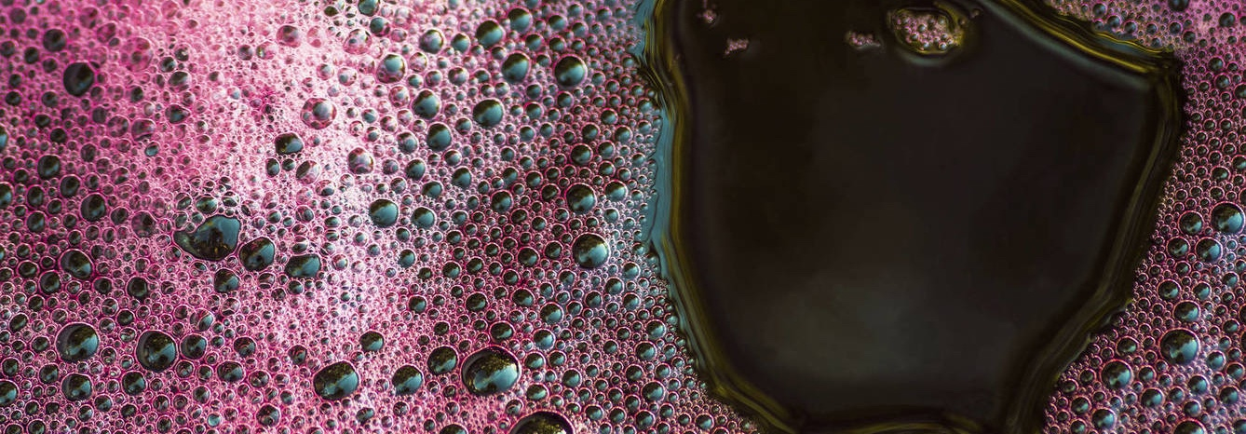
Sales and Revenue Stream
Casa Carmen, Inc. will continuously produce three blended wines, one red, one white and one rosé, adding two new products in each year of operation.
The first vintage will be available in
Summer 2018.
Our strategy to take Casa Carmen wines to market will rely heavily on selling directly to consumers. We plan on maintaining a heavy presence at farmers’ markets and wine festivals to increase brand awareness. Local restaurants and stores will also carry our wines.

Slide 14

The main point of sale will be our renovated tasting room and cellar, opening by appointment in Summer 2018 and to the public Summer 2019. Full wine tastings will be available for $25 with complimentary Spanish-style tapas, a winery experience unique to Casa Carmen.
We were taught good wine should be shared with good food and friends. We want our customers to feel like part of the Casa Carmen family.
Based on these core sales methods, along with wine club memberships, tours, and on-site events, our projections estimate profitability by third year of operation. We intend to increase wine production to 2,000 cases annually by year five.

Slide 15
Unique Market Competition
Unlike most industries, other wineries in the region are not our competitors, but our partners.
Because only 3% of the Maryland wine market currently belongs to local wines, there is significant opportunity for all winemakers to capture a larger segment of the market. The best way to achieve this is through collaboration that will increase the quality of Maryland wine and expand its influence.
For example, during the first two years of operation Casa Carmen will crush and ferment its grapes at the facilities of partner winery Crow Vineyards before finishing and storing the wine on Casa Carmen premises.
In addition, we’ve partnered with both Crow Vineyards and Broken Spoke Winery to ensure each winery produces wines without overlap. Comparable versions of our old-world, dry blends are not produced by our partners.

Slide 16

What We’ve Got in the Cellar
In addition to the annual release of a blended white, a blended red, and a blended rosé, we plan to release some special wines in the coming years:
2019
2020
2021
Reserve Red
Reserve White
Sparkling Wine
Reserve Rosé
Gran Reserva (Select Reserve)
Dry Sherry

Slide 17

The Proprietor’s Wine Club at Casa Carmen
Those interested in supporting Casa Carmen, Inc. will also join the Proprietor’s Wine Club. Only open to shareholders of the Company, the Proprietor’s Wine Club makes you part of the Casa Carmen family. In addition to the established benefits that come with being an investor, membership in the Proprietor’s Wine Club comes with a series of special perks:
1
Receive one case of wine per year, including limited release select and reserve wines.
2
Access free tastings at the winery for you and your guests.
3
Have your own personalized wine locker in the Casa Carmen cellar.
4
Be invited as our guest for select events at the winery open only to Proprietor’s Wine Club members.
5
Rent our Casa Carmen facilities at a reduced price for private events.

Slide 18
Thank You
The Casa Carmen, Inc. family would like to thank you for taking the time to learn about our company and this investment opportunity. The Chesapeake Bay is a lovely place, and we’d be happy to have you join us at our vineyard. Our invitation will deliver value to shareholders via:
Equity in a winery committed to high quality and led by world-renowned winemaker John Levenberg.
The potential for significant ROI-explain? as local wines continue to capture larger segments of the Maryland wine market.
Access to the Proprietor’s Wine Club with benefits including free wine releases, tastings, and a special place at Casa Carmen as our honored guest.
Felipe Pallares, Director/Proprietor
www.casacarmenwines.com

