Slide 1
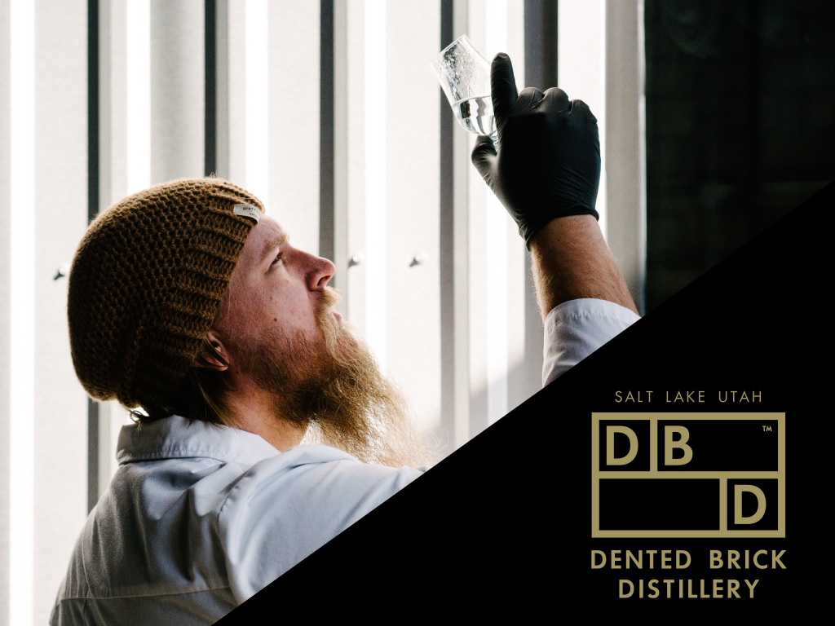

Slide 2

DENTED BRICK DISTILLERY: KEY FACTS
Dented Brick Distillery is a fully operational and truly craft distillery. Our spirits are distilled from 100% organic, locally sourced ingredients and artesian well water located on-site at the distillery. Each batch is handcrafted with passion and skill to bring you authentic
artisan spirits.
Key Highlights:
Fully operational distillery
with on-site artesian well.
Multiple awards at international
spirits competitions.
Strategic wholesale partnerships
for coverage in all 50 states.
American-made, Utah-based,
authentic spirits.
Industry - Value & Premium Spirits
Market Size - $11.6 billion
Target Customer - Millennials

Slide 3
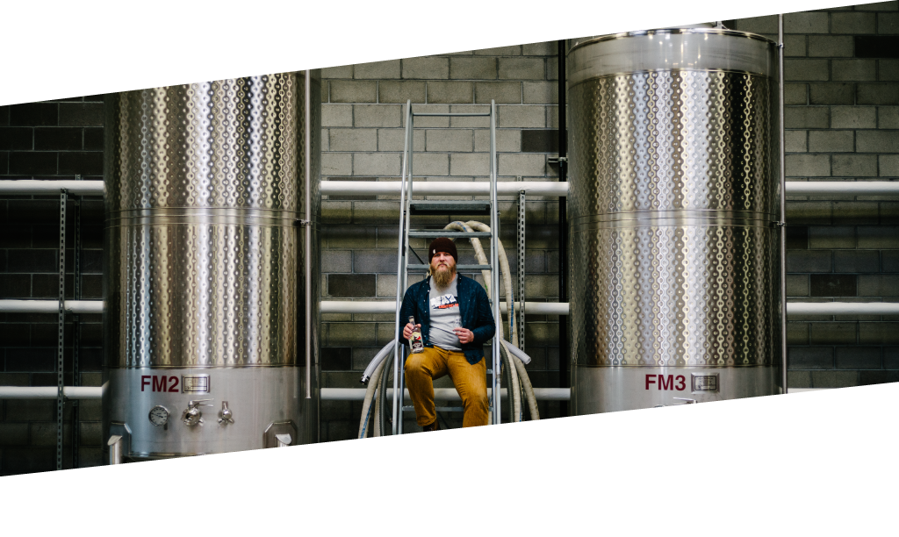

THE SEARCH FOR CRAFT BRANDS
The spirits industry has been consistently trending up over the past decade.
Millennials are driving this shift, by becoming more savvy about their purchases and searching for quality they can trust.
Spirits now command nearly 36% of the alcohol market,
with craft and small batch products such as Tito’s
Handmade Vodka and Hendrick’s Gin becoming
especially attractive brands.
36%
They’re not just looking for something flashy and new…
They’re searching for something authentic.

Slide 4
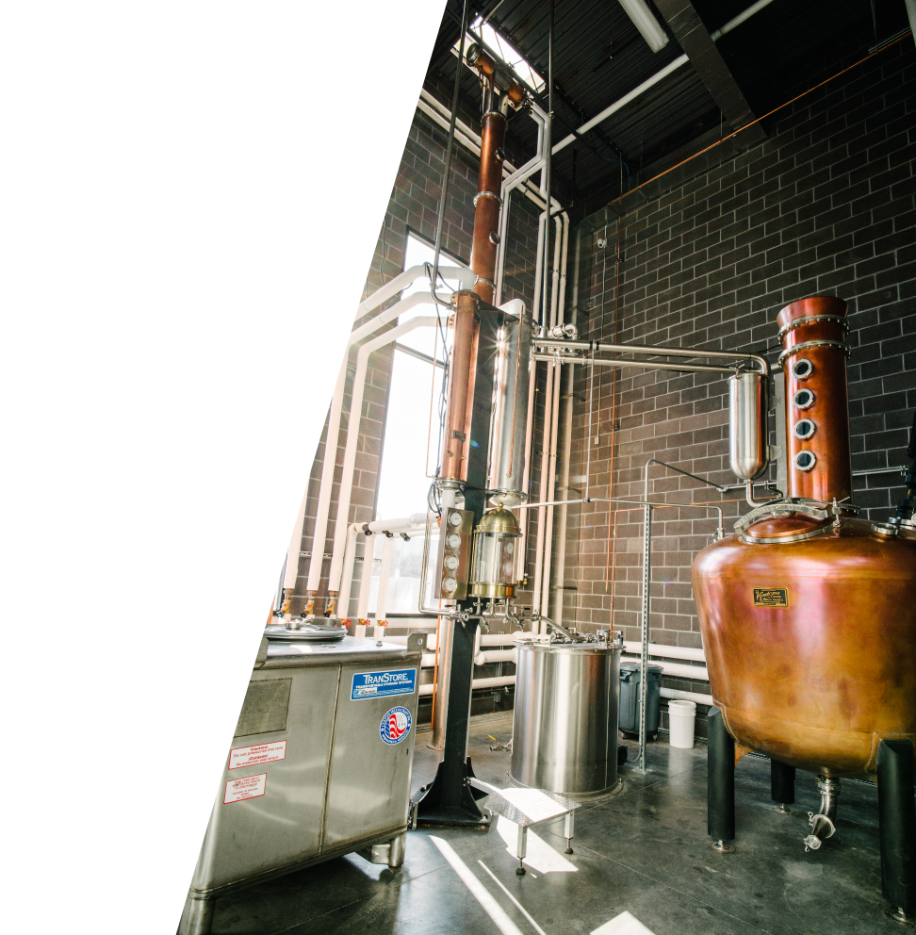
AUTHENTIC CRAFT SPIRITS
Dented Brick Distillery
is built on authenticity.
100% organic, locally sourced ingredients
Artesian water from the Salt Lake aquifer
An experienced head distiller
A portfolio of spirits inspired by historic Utah figures
A distillery built with even the dented bricks
Every aspect of
Dented Brick is designed to
deliver handcrafted spirits.
From grain to glass.

Slide 5
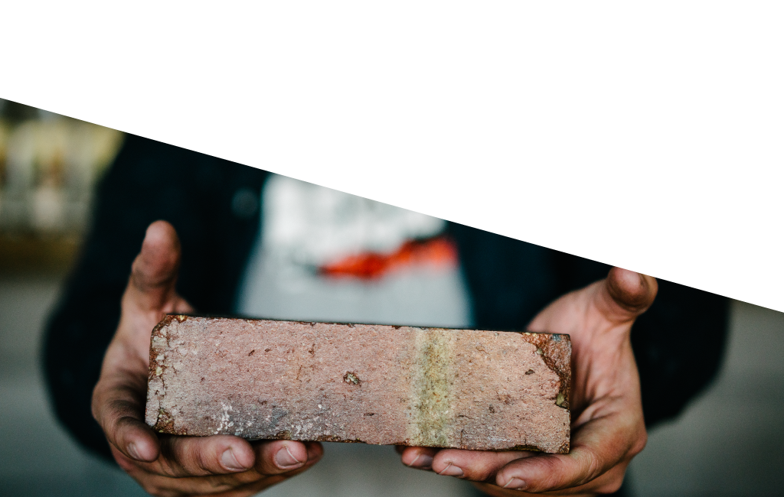
OUR DENTED BRICKS: A HISTORY
Our fully operational distillery sits on the site of 19th-century distiller Hugh Moon’s operations.
A noted entrepreneur, Moon sold his spirits to church leader Brigham Young and his Mormon followers, and they all agreed that his product, distilled from local grain and water, was the best.
When we first visited the historical site of Hugh Moon’s spirits operations, we found an old brick house. Built in 1919, it still stood as an inspiration to us. The house had character, and an artesian well that drew from the Salt Lake aquifer was in the backyard.
As we stood on the front porch, we knew we were in the right place.

Slide 6
OUR DENTED BRICKS: A HISTORY (CONTINUED)
We pulled down the house by hand and kept every brick--even the dented ones. Those bricks laid the foundation of our distillery, and Hugh Moon inspired our spirits. We even plan on naming our white whiskey after him
Every batch of Dented Brick spirits is handcrafted with passion in the spirit of
Salt Lake history.
We aim to deliver only the truest craft spirits.

Slide 7
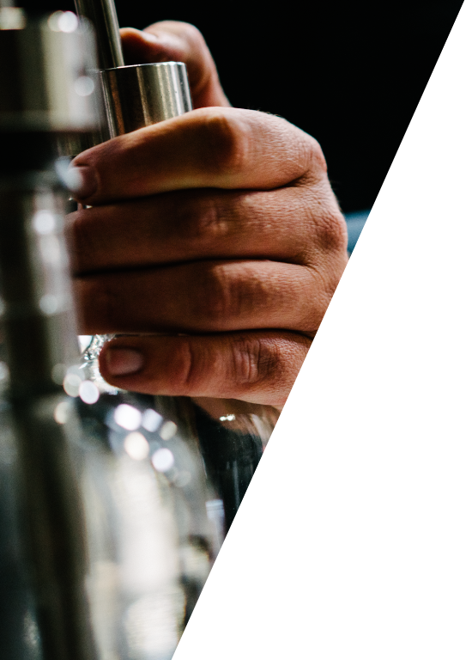
THE SPIRITS OF DENTED BRICK
Antelope Island Rum
Though only a patch of land in Great Salt Lake, Antelope Island and its herds of grazing pronghorn inspired our take on island rum. Firmly rooted in rum making history, our flavor comes from the highest quality organic sugar cane, rich molasses, aromatic yeast, and repure water.
Carl Ethan Akeley Gin
Akeley Gin is an innovative "rooibos tea gin” with a deep flavor profile unlike any other. The spirit is made in house from a short list of botanicals, with Utah-grown, organic, and non-GMO wheat and rye.
Roofraiser Vodka
When we tried to fit our pot still in the distillery, it was too tall. So we raised the roof. Our vodka is as simple as that. It starts sweet, finishes rye, and proves the benefit of handcrafting with non-GMO, organic wheat and rye and artesian well water.

Slide 8
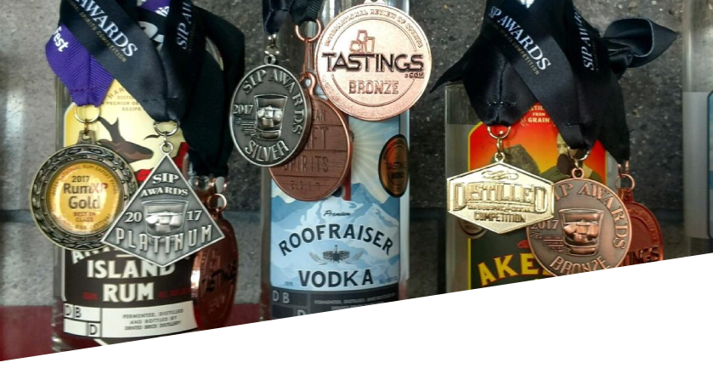
THE SPIRIT AWARD
Carl Ethan Akeley Gin
Silver Medal
SIP Awards
Gold Medal
San Diego Spirit and
Cocktail Competition
Silver Medal
New York International
Spirits Competition
Antelope Island Rum
Platinum Medal
SIP Awards
Best of Class
International Competition
Miami, FL
Gold Medal
International Rum
Competition Miami FL
Roofraiser Vodka
Bronze Medal
San Francisco International
Spirits Competition
Bronze Medal
American Craft Spirits
Association
Bronze Medal
New York International
Spirits Competition

Slide 9
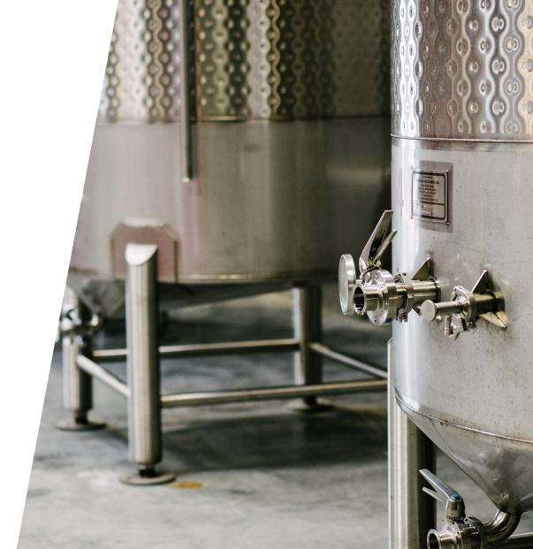
FUTURE FLAVOR PROFILES
Hugh Moon White Whiskey
The story of Hugh Moon continues to inspire us every day, so we plan to put his name on our bottle. He was a Utah man and entrepreneur who made the best spirits around from Utah grain. We’ll toast to that tradition.
Value/Well Spirits
We plan on rounding out our portfolio with a value line
of our rum, gin, and vodka. Used mainly in bars and restaurants, our value spirits will increase Dented Brick value to distributors, grow our customer base,
And introduce the world to value craft spirits.
Aged Whiskey and Dark Rum
There’s always room to make a good thing better. Sometimes that room is inside of cabernet barrels, where we plan on aging our Antelope Island Rum and Hugh Moon Whiskey to develop delicious new flavor profiles.

Slide 10
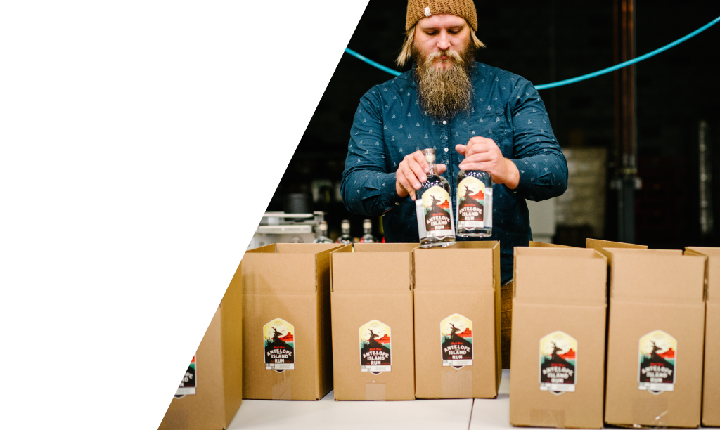
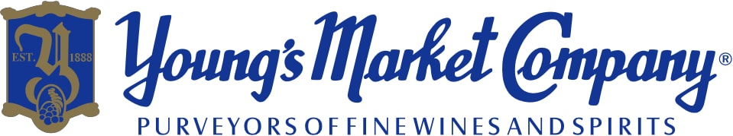
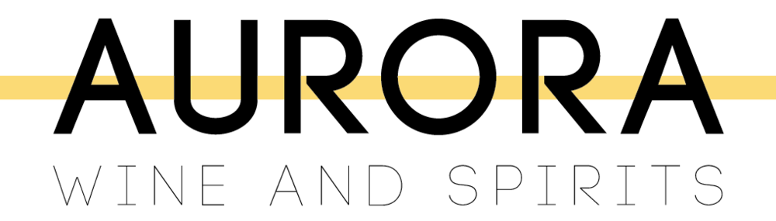
OUR WHOLESALE PARTNER
Founded in 1888 in Los Angeles
Third largest wholesaler in US. with trades in 10 western states
Market leader in California with 50% market share
Highly skilled in wine and craft spirits sales
Existing brands include both mega brands (e.g. Jack Daniels, José Curvo, Tito’s) and craft brands (e.g. Buffalo Trace Bourbon, Hendricks Gin)
National wholesale distributor with sales in
every major U.S. market
Specialized in wine and craft spirits
Staffed with industry veterans, many with
more than 40 years in spirits

Slide 11
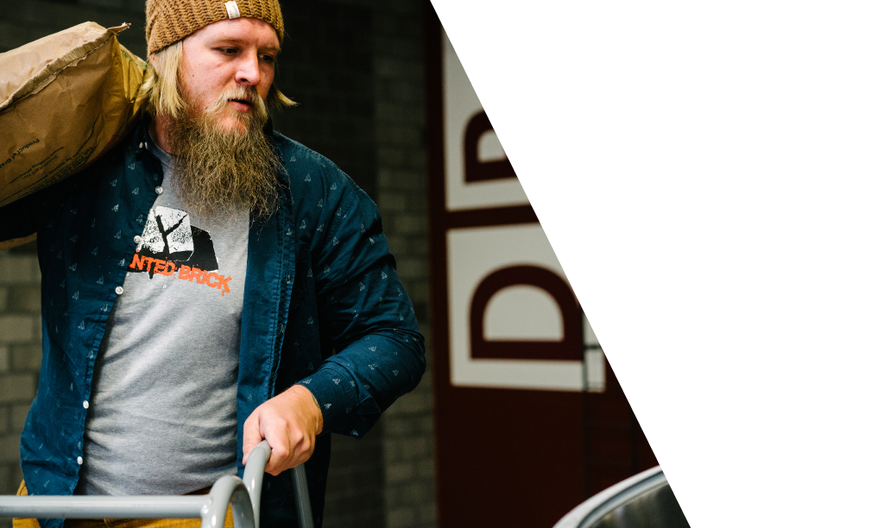
MEET THE BRICKLAYERS
Marc Christensen
Founder/Managing Member - The vision for developing a distillery that is focused on truly handcrafted spirits belongs to Marc. His leadership, based on 20 years’ experience as founder and CEO of OTW Safety,
secured early fundraising and construction of the distillery.
Mike McSorley
Head Distiller - As an award-winning bartender and mixologist,
a beverage and hospitality consultant, a distiller, and a small business owner, Michael McSorley has striven to be among the most well-rounded participants in the beverage alcohol industry.
Karina Soriano
Sales Executive - Sociometrician with critical focus on customer and contributor experience. Committed to effective communication and evocative storytelling, I employ research, develop strategy, and collaborate creatively to ensure campaign and client success.

Slide 12
THE REMAINING SLIDES WILL BE FEATURED ON THE PRIVATE OR “BUSINESS PLAN” HALF OF YOUR ONLINE CAMPAIGN.
ONCE YOUR PROFILE IS LAUNCHED AND LIVE, INVESTORS MUST REQUEST ACCESS TO VIEW THE REMAINING INFORMATION.

Slide 13
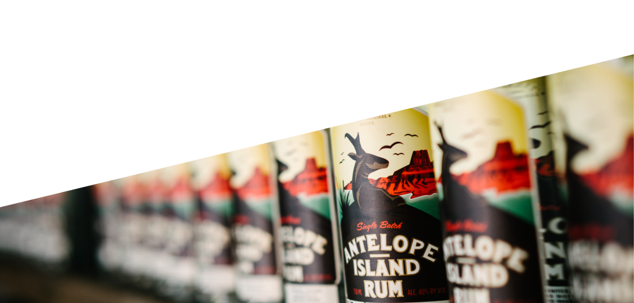
MARKET OPPORTUNITY
While craft beer and breweries have been the focus of the alcohol industry for the past several years, the beer market is quickly becoming over-saturated. Distilled spirits offer an unexplored market for many, especially Millennials.
Craft brands are quickly becoming valuable players in that market space. Consumers are looking for authenticity and brands they can trust, and key players have noticed.
Among others, Pernod Ricard purchased a majority stake in Monkey 47 gin despite already owning mainstream gin brands Beefeater and Seagram’s.
By leveraging consumer desire for authentic ingredients
and unique character, Dented Brick Distillery stands
poised to achieve significant success in a
growing craft industry.
The premium and value spirits industry is an
$11.6 billion industry.

Slide 14
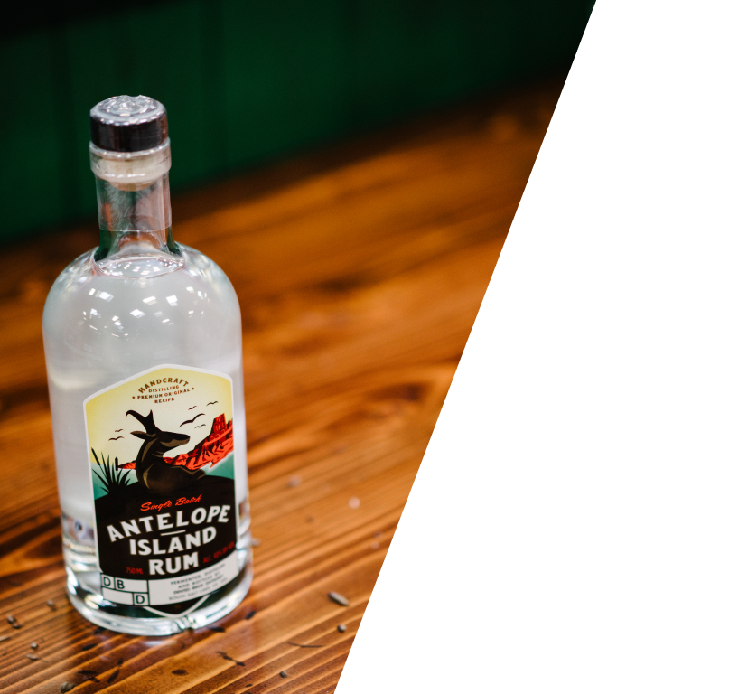
REVENUE AND PRICING MODEL
We have produced 500+ cases of our premium line distilled spirits and are currently generating revenue. We price competitively, but due to low cost of entry we are able to maintain high margins.
We currently retail in 11 states and every “wet” county in Utah. More states are on the way, with a California chain looking to become an off-premise sales partner.
NOTE: Future revenue streams include co-branding of
promotional items and private labelling
Per
Bottle
Retail MSRP = $26*
Average wholesale = $XX
Cost of Goods Sold = $X**
Average Margin = XX%
*MSRP differs based on state taxes
**Excluding cost of freight

Slide 15
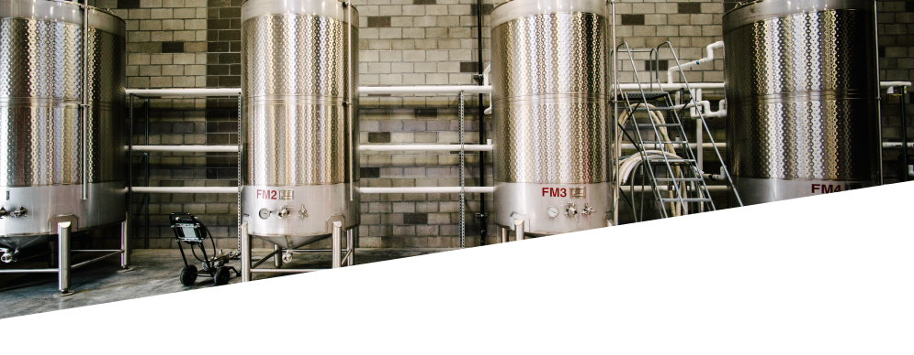
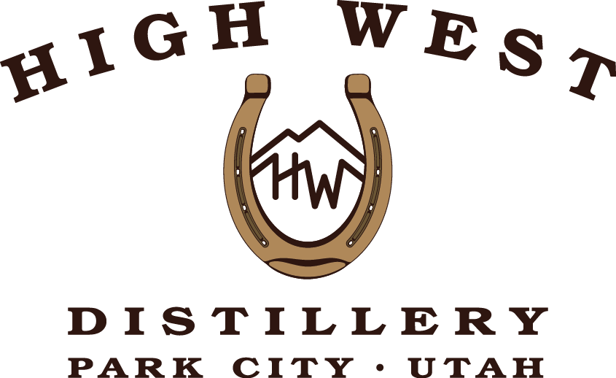
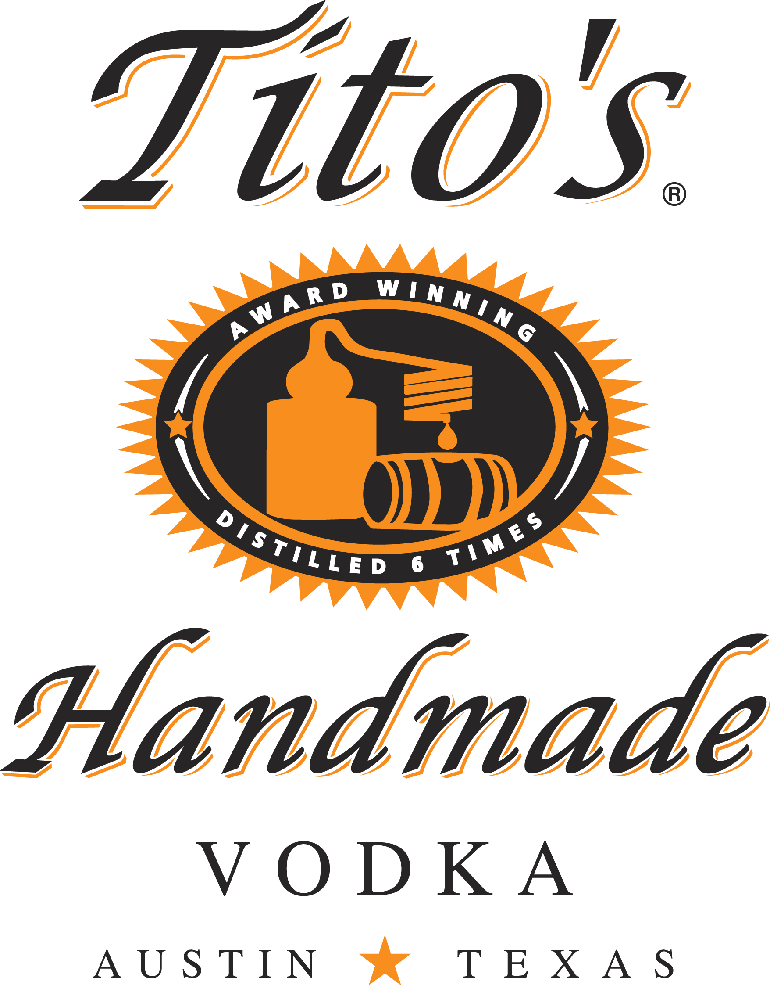
PLAYERS AND POTENTIAL FOR CRAFT SPIRITS
The spirits industry totalled $25.2 billion in 2016. Existing U.S. craft spirit brands only
contributed $2.4 billion of that total due to the dominance of mass market brands.
However, that indicates there is significant room for growth in the craft spirits sector.
Direct Competitors
High West Distillery
The first legally licensed distillery in Utah since prohibition, High West produces whiskies that are widely distributed. Though it is another Utah distiller, our portfolio is more
diversified and has received more prestigious awards.
Tito’s Handmade Vodka
A distillery that has met success by leveraging “authentic” and “handmade” stories.
However, Tito’s is slowly losing its title of “craft” as it has grown into a mega brand.
And unlike Dented Brick, the stories it’s built upon are more legend than fact.

Slide 16
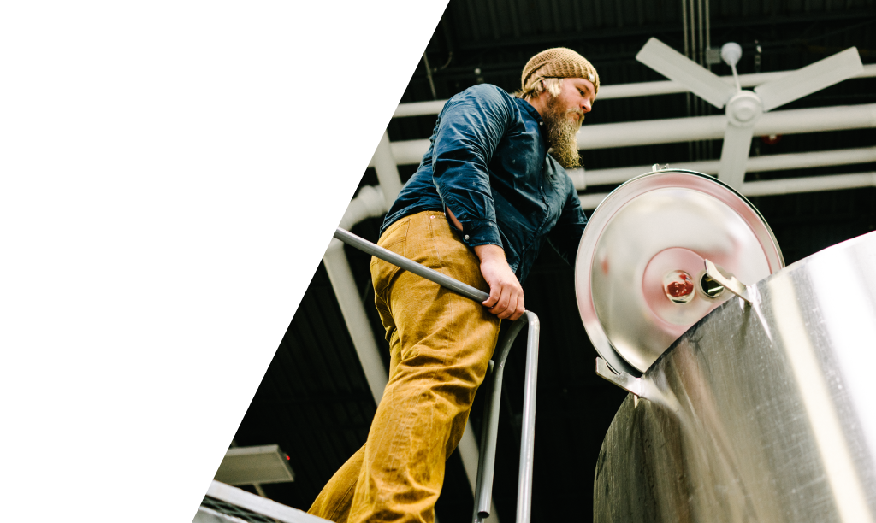
STRATEGIES FOR GROWTH AND EXIT
Our main strategies moving forward are to expand our spirits offering and to increase our distribution network.
UPCOMING SPIRITS
Hugh Moon White Whiskey
Made from Utah grains and artesian water
Aged Whiskey
Our whiskey aged in cabernet barrels
for super premium taste
Dark Rum
Super premium edition of our
Antelope Island Rum

Slide 17
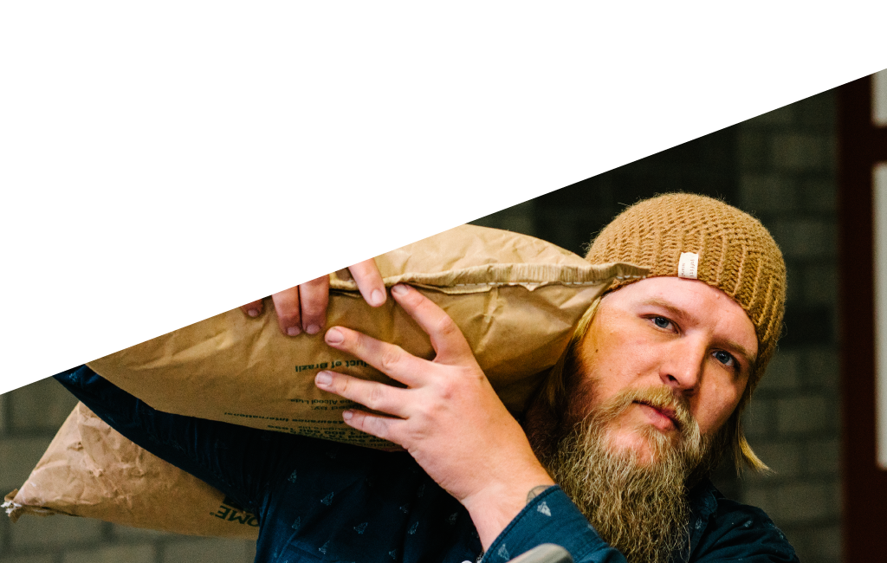
STRATEGIES FOR GROWTH AND EXIT (CONTINUED)
We anticipate the market desire for authentic,
handcrafted spirits will allow Dented Brick
Distillery to grow rapidly and will make us
an attractive acquisition prospect for a
larger corporation such as
Constellation Brands or
Gruppo Campari.
DISTRIBUTION
NETWORK GROWTH
New States
Our next targets are West Virginia,
Texas, and Oklahoma.
Off-premise Sales
As distribution increases, so will the
Number of off-premise locations.
Dark Rum
We will also drive marketing efforts
To connect directly with potential
Off-premise owners.

Slide 18

THANK YOU
We at the Dented Brick Distillery would like to thank you for taking the time to learn about our company, the history behind our dented bricks, and this investment opportunity. We’re now inviting investors to get involved with a passionate, authentic distilling team delivering value to shareholders via:
Favorable profit margins achieved through competitive
retail pricing while maintaining low cost of goods sold.
Equity in revenue-positive facility on historically significant
land where head distiller Michael McSorle has already crafted
3 award-winning spirits available for purchase in 11 states.
The potential for significant ROI as the spirits industry grows and
consumer desire for authenticity turns craft brands into mega brands.
Marc Christensen
Founder/Managing Partner
www.dentedbrick.com

